Slide 1
Iatrogenic/DRUG-induced INJURY of the GI TRACT and LIVER
Fátima Carneiro*, Augusta Cipriano**, Paula Borralho***
*Faculdade de Medicina da Universidade do Porto, *Hospital Universitário São João, *Ipatimup/i3S, Porto; **Hospital Universitário de Coimbra; ***Hospital CUF Descobertas,Lisboa

Slide 2
Disclosure of Relevant Financial Relationships
Dr. Fátima Carneiro declares she has no
conflict(s) of interest to disclose
RDC Nº 96/08 da ANVISA

Slide 3
Drug Induced Liver Injury (DILI) The pathological approach
Approach to liver biopsy
Main patterns of liver injury and differential diagnosis
Difficult differentials: drug induced autoimmune (like) hepatitis (DI-ALH) and autoimmune hepatitis (AIH)

Slide 4
Use of Liver Biopsy (LB) in DILI
Evaluation of a patient with suspected DILI
Not required for the diagnosis; performed in ~50% of cases
Clinical decision – contact the pathologist prior to LB
can be helpful: a portion of the biopsy may be need to:
- Culture or viral PCR test
  - Glutaraldehyde for EM, if mitochondrial injury is suspected
  - Frozen sections, if microvesicular steatosis is suspected

Slide 5

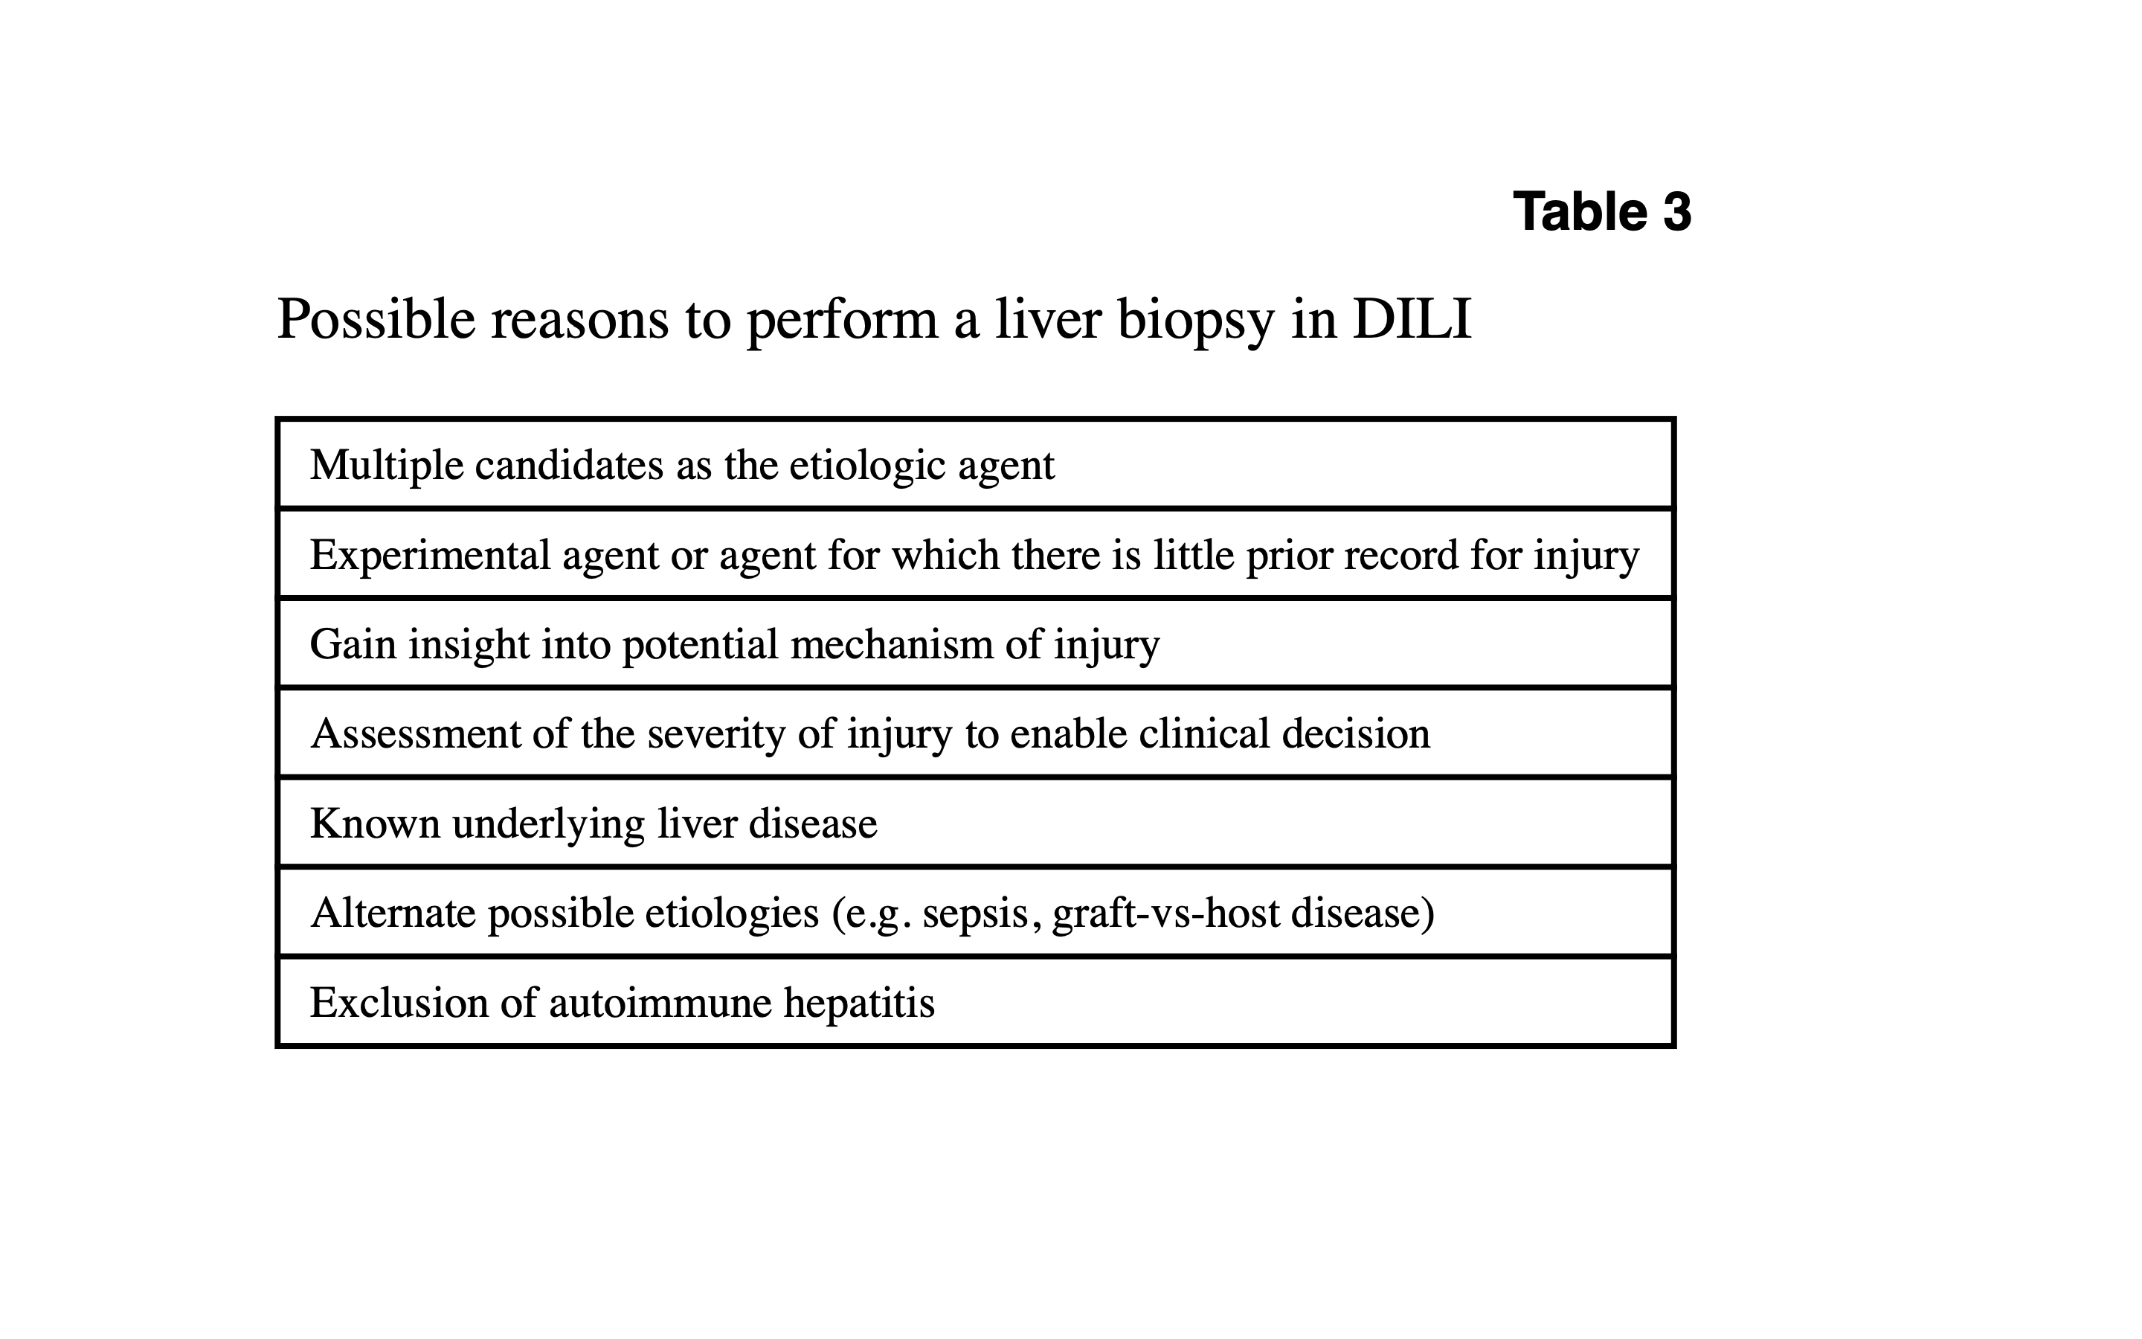
Indications to perform a liver biopsy in DILI

Slide 6
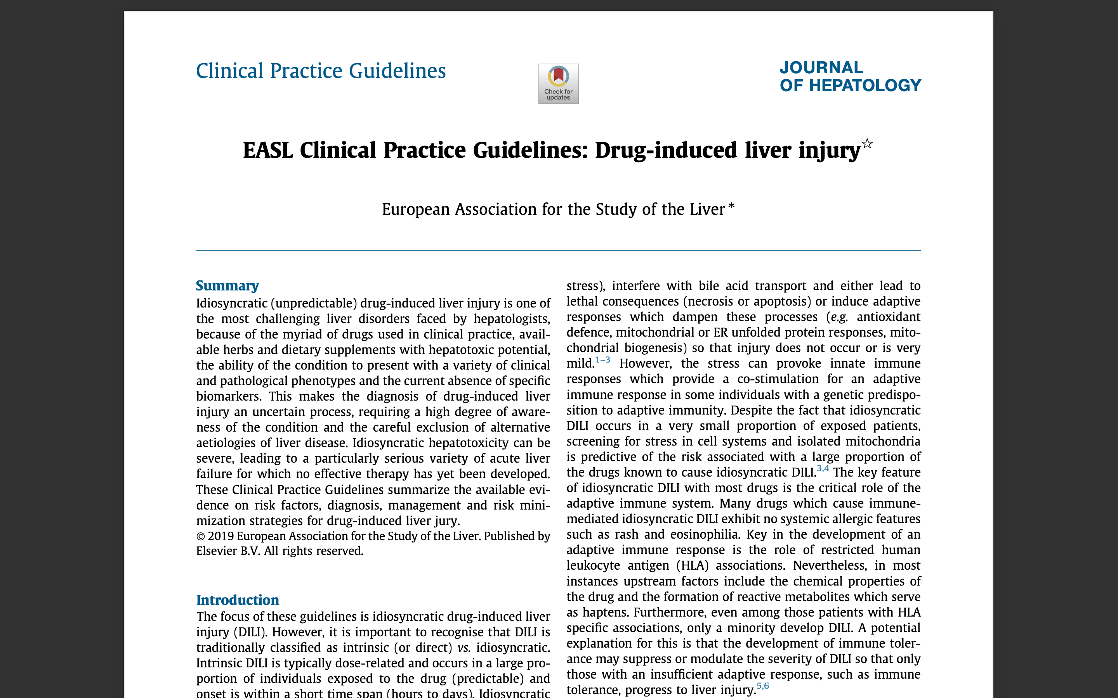
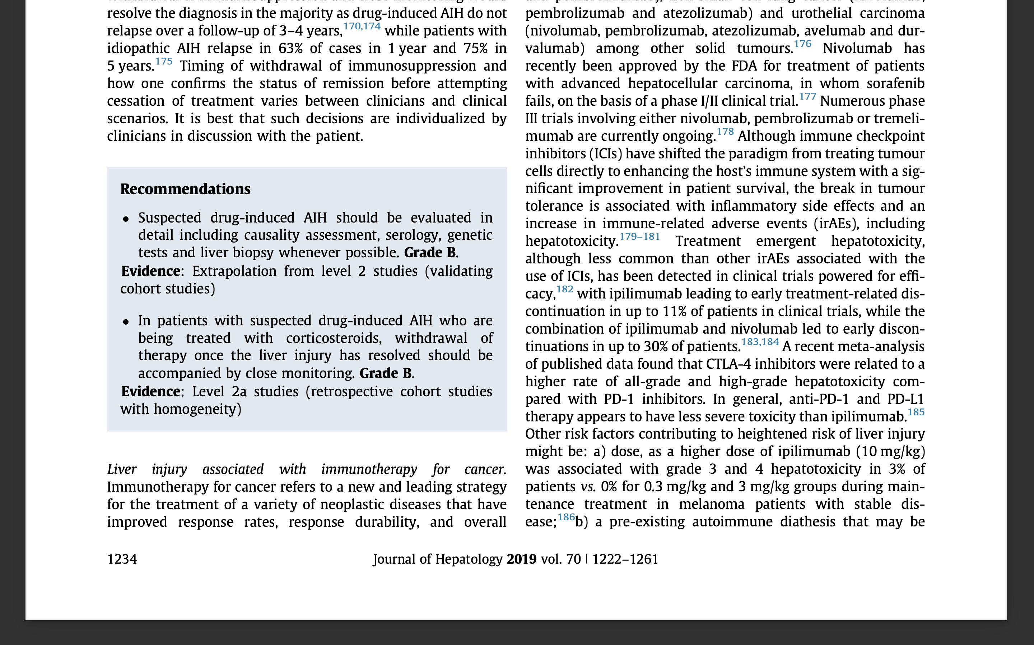
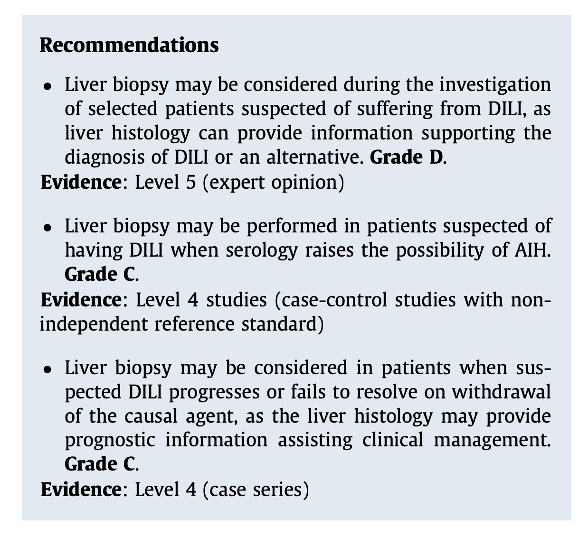
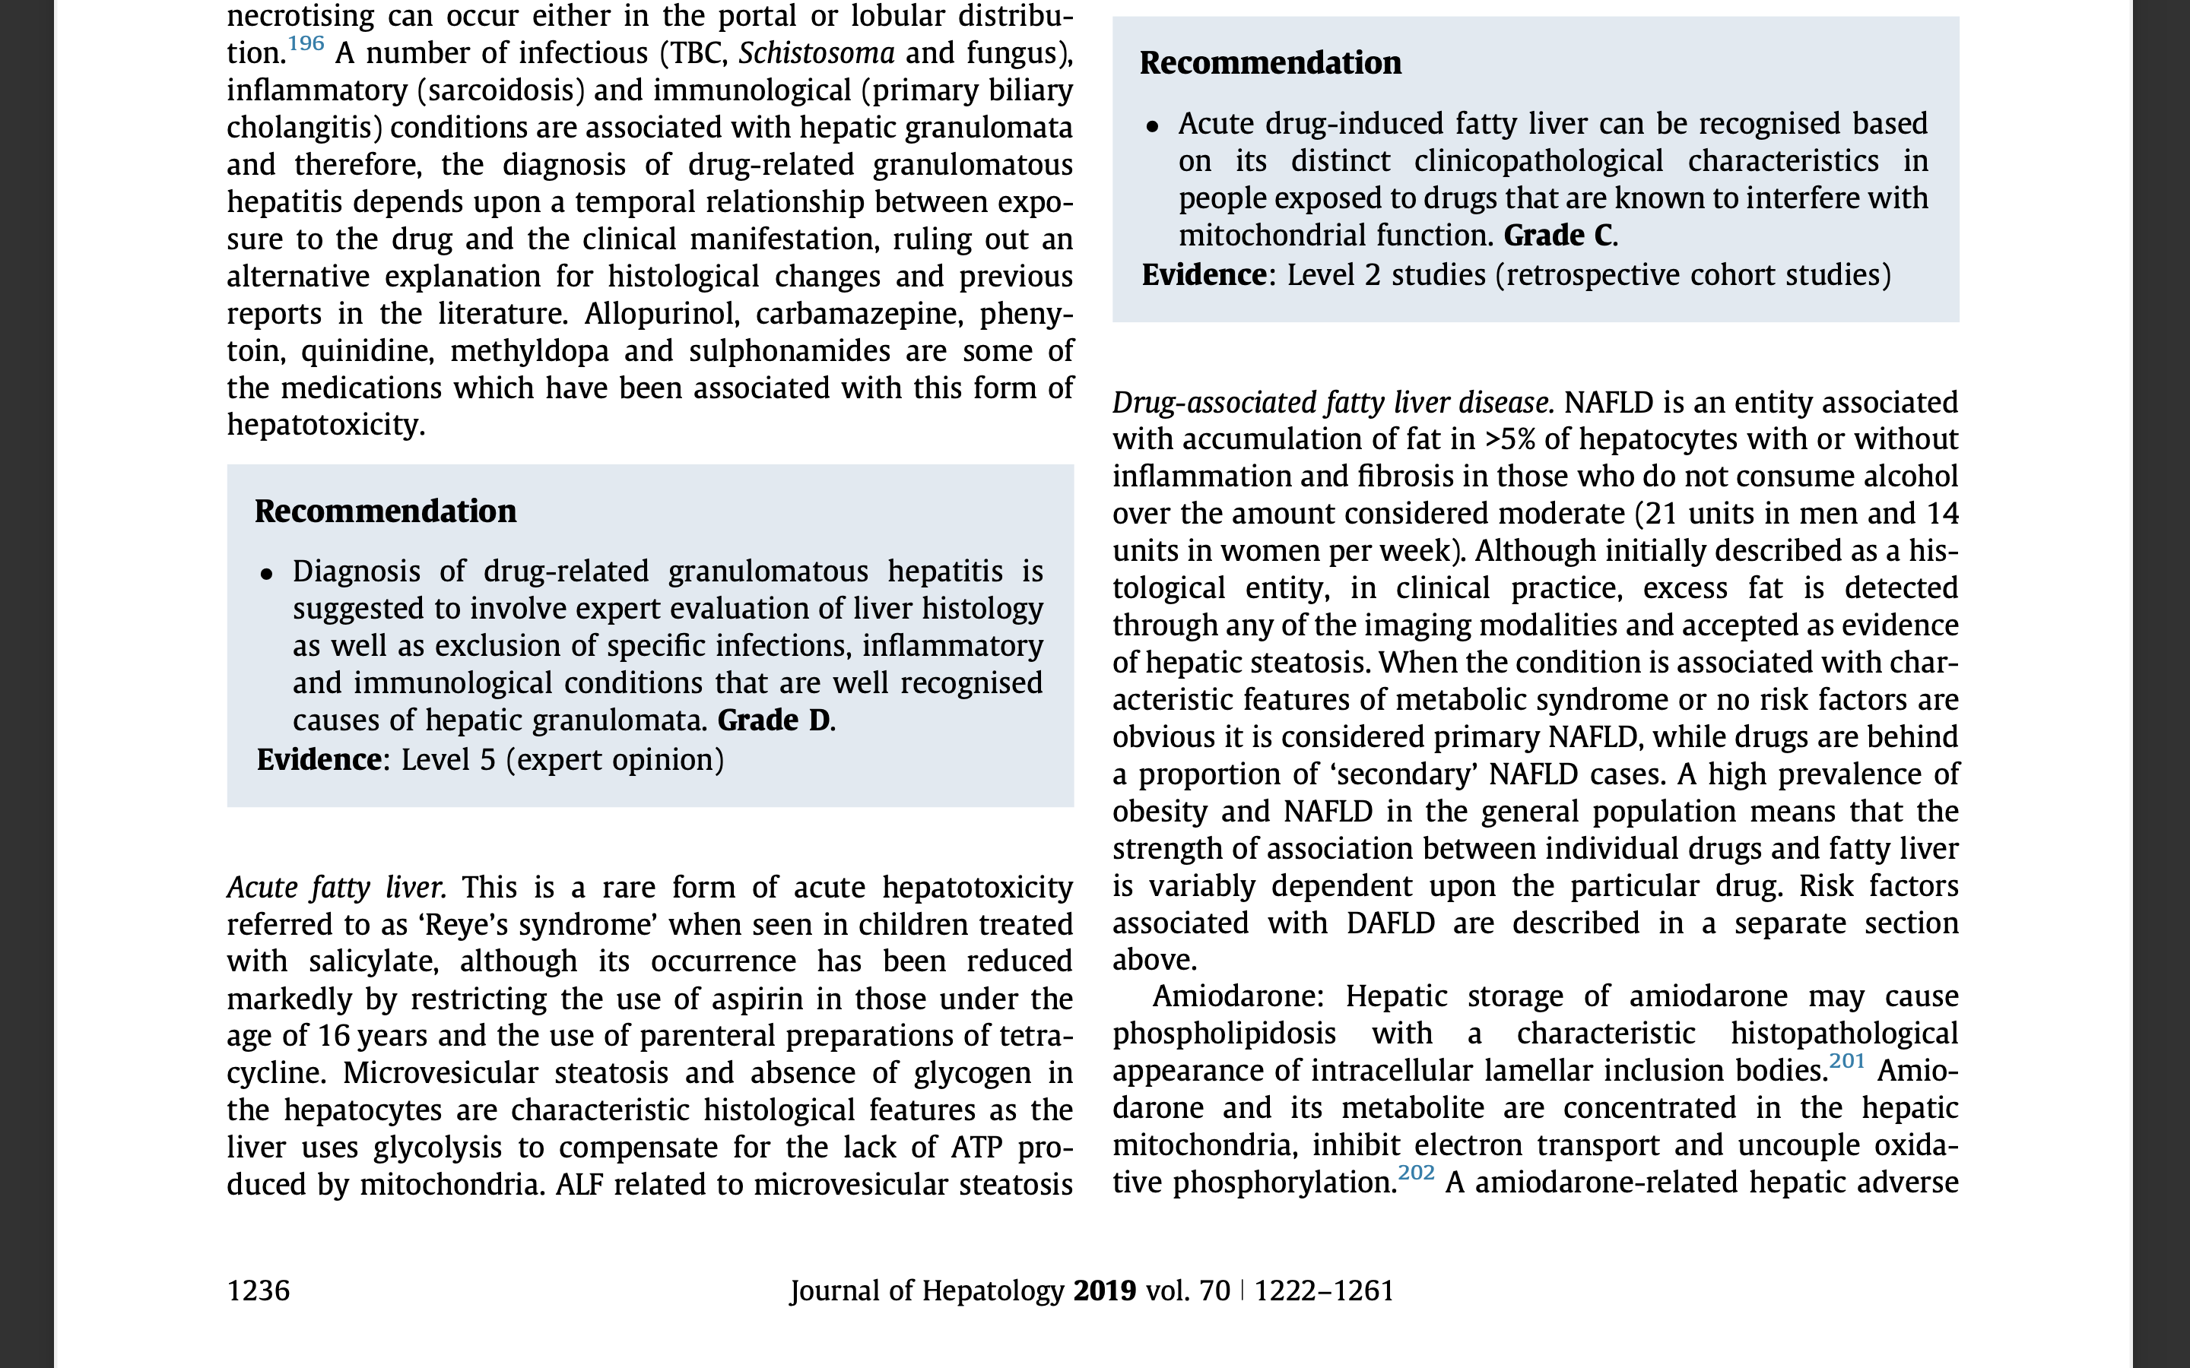
EASL Clinical Practice Guidelines

Slide 7
DILI- Liver biopsy
Particular challenges – careful systematic approach
Any pattern of liver injury, even tumors, can be induced by drugs
Wide range of potential DILI agents
  Prescription and non-prescription medications
  Environmental and occupational toxins
  Herbal and dietary supplements
  Drugs of abuse
Requires mandatory clinical correlation
Always a diagnosis of exclusion
Morphologic changes can be very subtle
DE Kleiner. Gastroenterol Clin North Am. 2017 June

Slide 8
DILI:mechanisms of injury
DILI mechanisms
  Predictable, dose-dependent - intrinsic DILI
  Unpredictable, non-dose-dependent - idiosyncratic DILI
Biochemical Classification of DILI
  Hepatocellular - ALT - 2-5x and/or ALT/ALP > 5x
  Cholestatic – ALP - 3x and/or ALT/ALP < 2
  Mixed - ALT - 2-5x and ALP - 3x and/or and ALT/ALP 2-5x

Slide 9
Systematic approach of histology in potential DILI
Identify the pattern of injury
Identify the suspect agent(s)
  Drug, herbal, environmental exposures
  Appropriate time-line?
  Appropriate histologic injury pattern?
Exclude other causes of injury (or not)
Draw conclusions
  Comment on the elements of step 2
  Comment on any potential alternative etiologies that may require additional testing

Slide 10
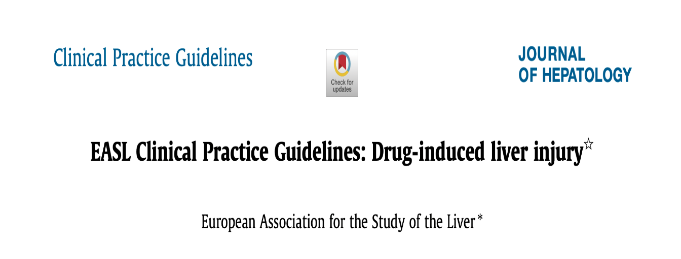
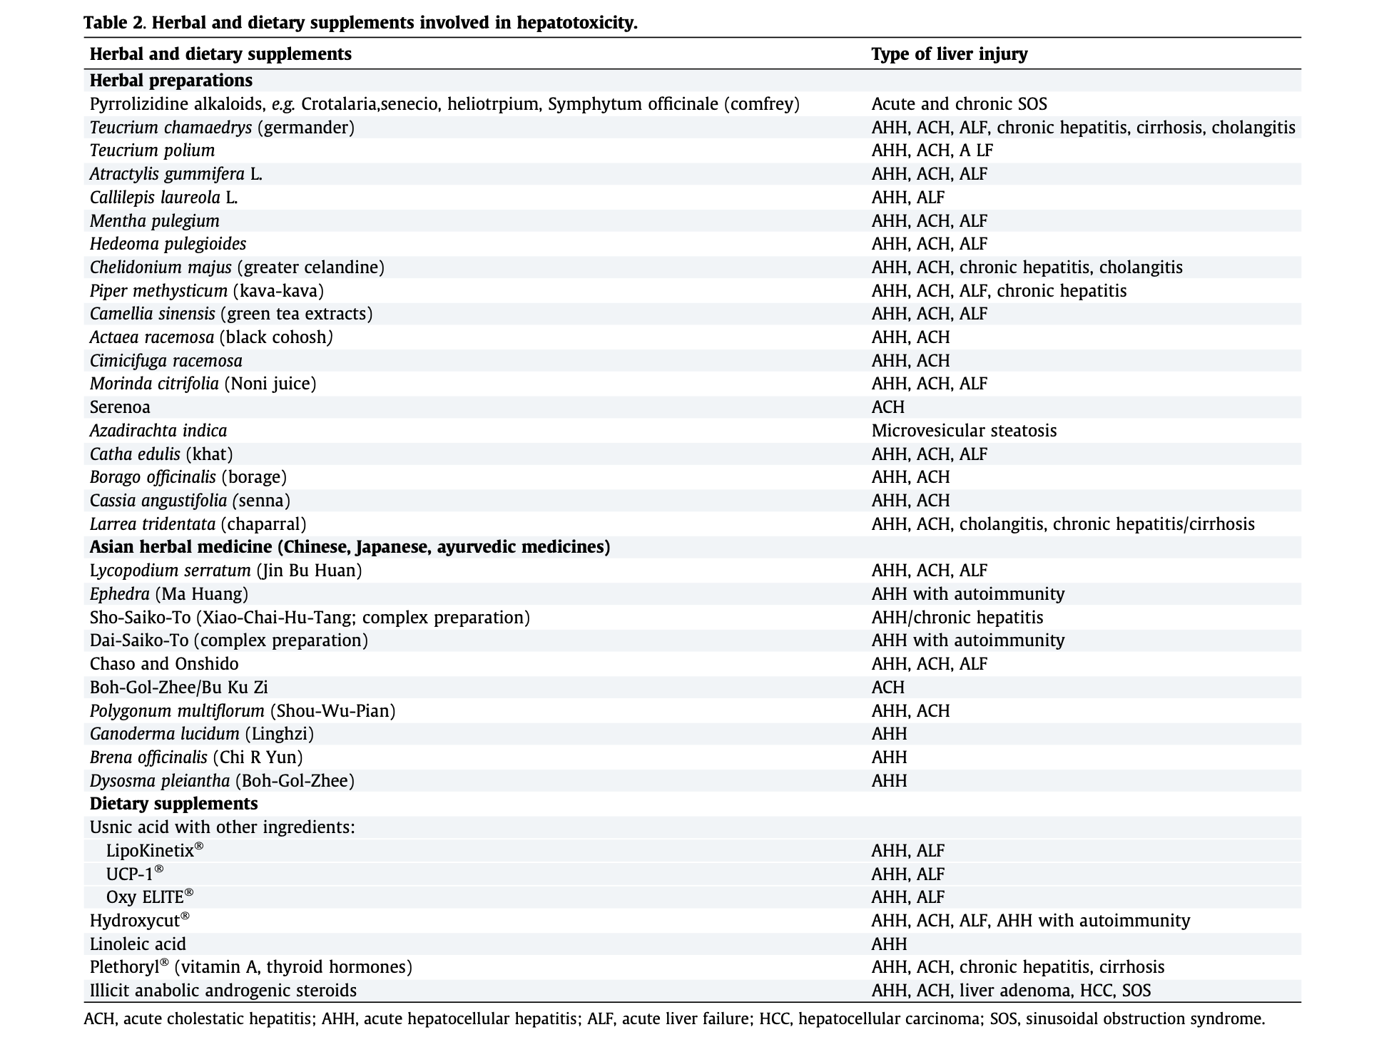
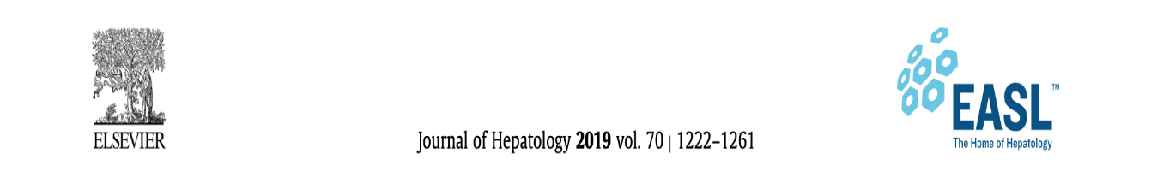
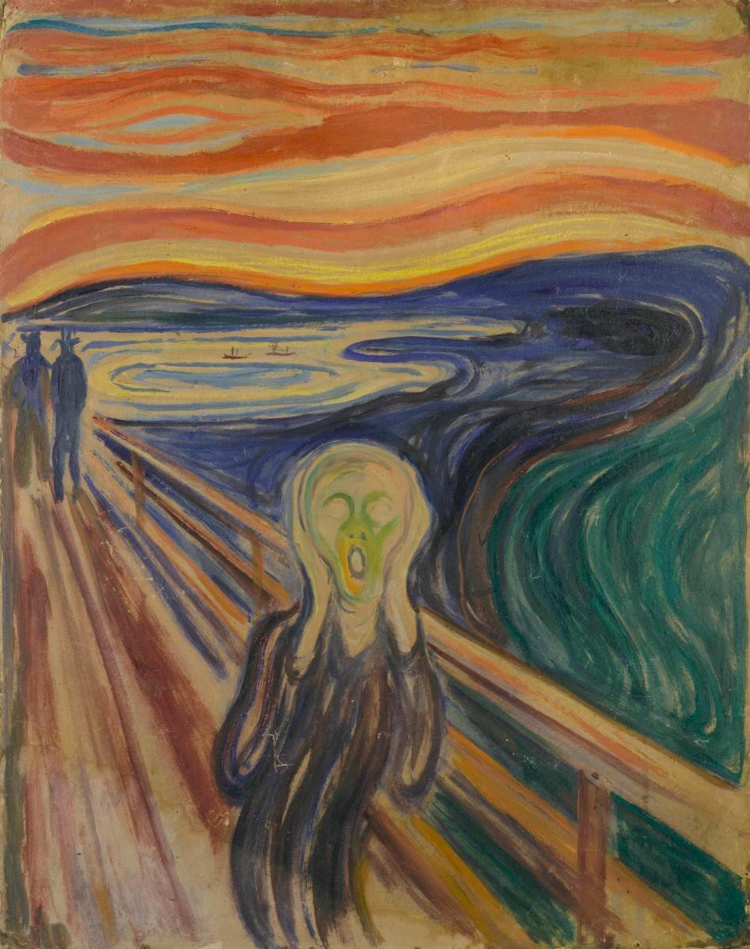




Slide 11
Role of the Pathologist
Integration and expert interpretion of histological changes (the pattern may suggest mechanism of toxicity)
Integrate patient’s medical and pharmaceutical history
Identify the pattern and the degree of injury
Correlation of the injury pattern with the literature for the suspected agents
Identification or exclusion of other competing etiologies
Algorithm for Biopsy Evaluation in Suspected Drug-Induced Liver Injury. From Kleiner DE. Liver histology in the diagnosis and prognosis of drug-induced liver injury. Clinical Liver Disease 2014;4(1):12–6; with permission

Slide 12
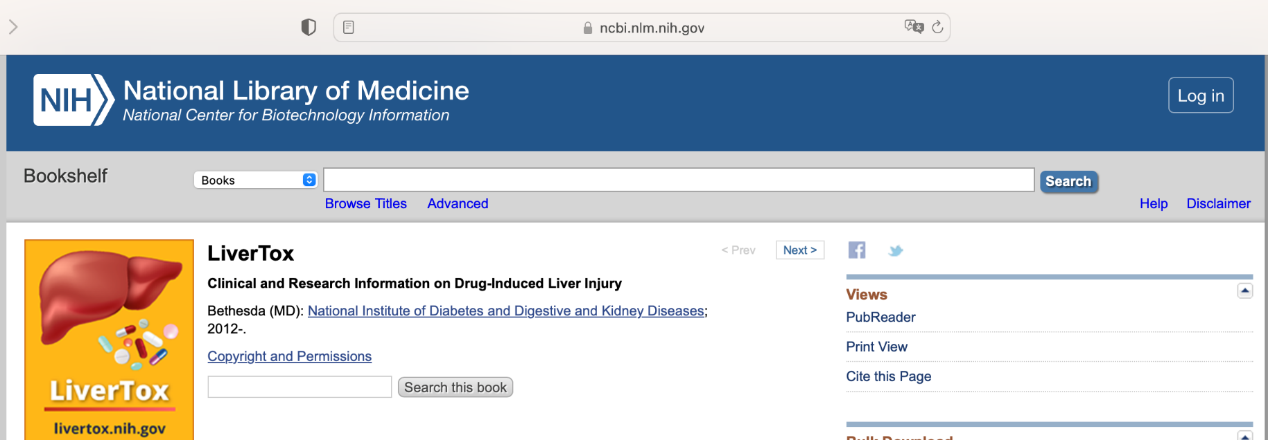
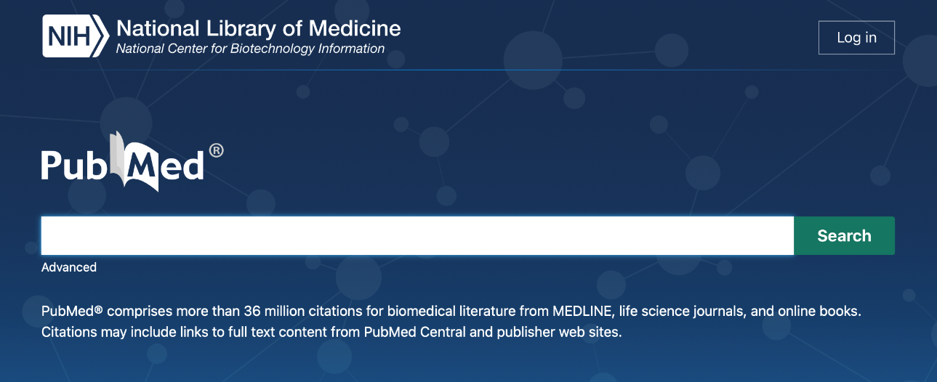
Slide Title
LiverTox – https://www.ncbi.nlm.nih.gov/books/NBK547852/
DILI specific chapters of major textbooks
PubMed – case reports, reviews

Slide 13
Histologic Patterns of Liver Injury
Necroinflammatory patterns
Cholestatic injury patterns
Steatosis and steatohepatitis
Vascular injury
Ground glass inclusions
Minimal changes

Slide 14
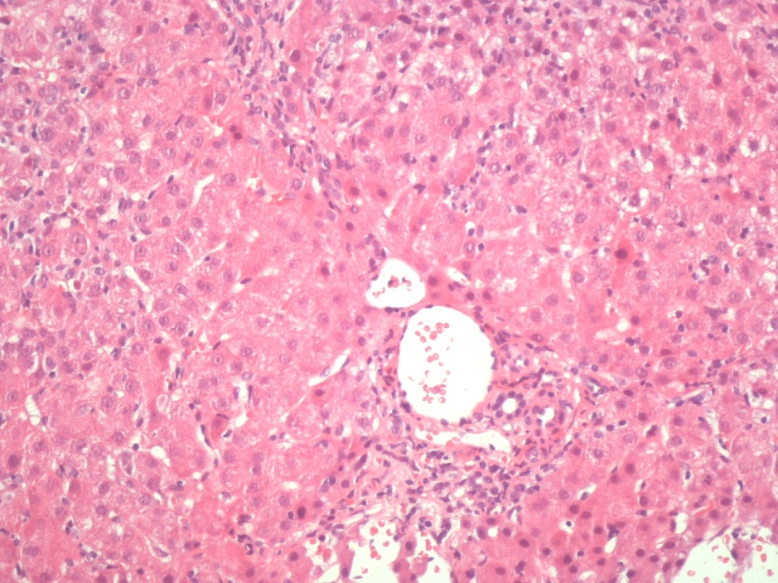
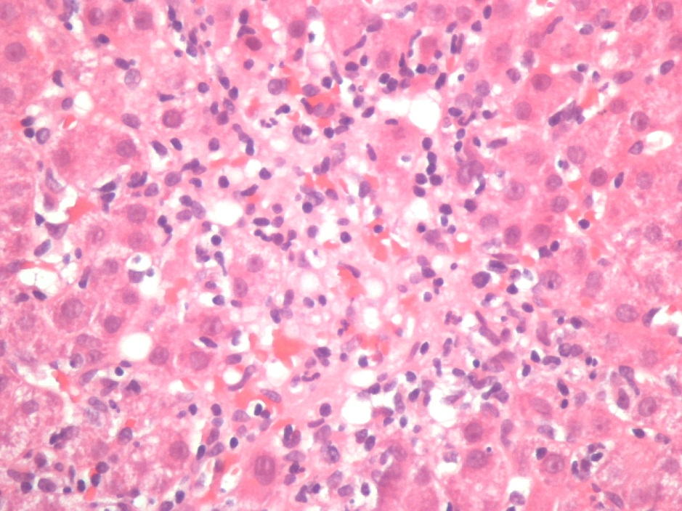
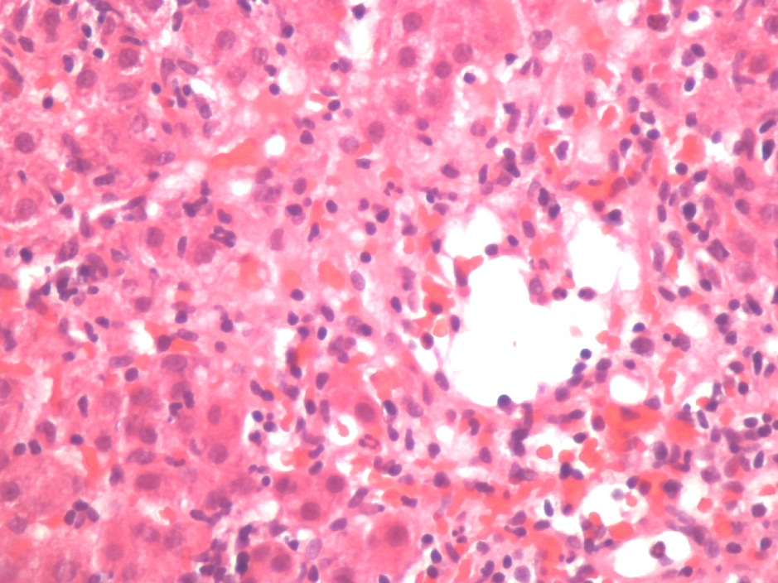
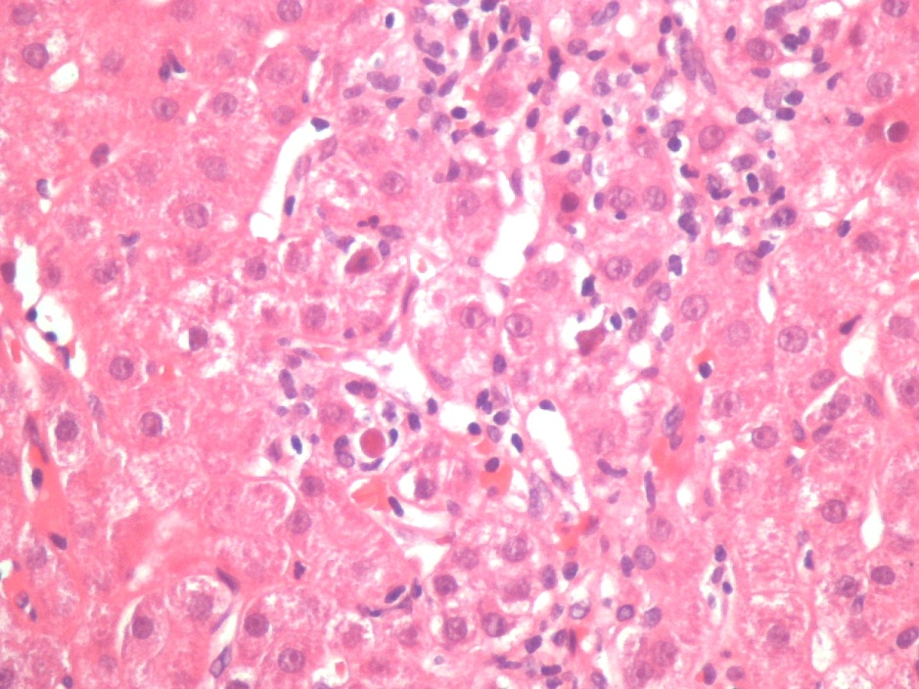
Acute Lobular Hepatitis

Slide 15
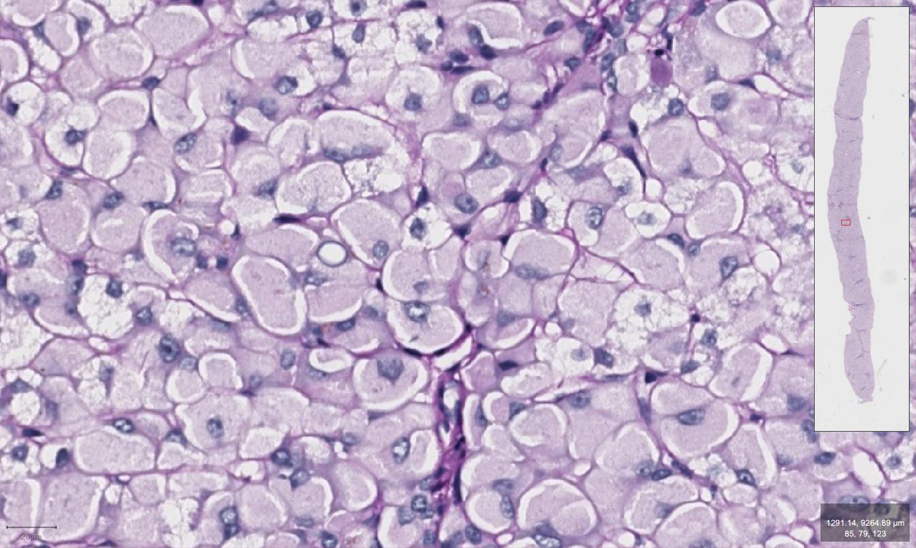
Ground-glass inclusions – differential diagnosis
HBs Ag PAS-/orcein+/Victoria blue+
Lafora disease (myoclonic epilepsy) PAS+/coloidal iron+
Storage disease
  Glycogen storage disease type IV PAS+
  Fibrinogen storage disease PAS-
Cyanamide – treatment of alcohol aversion PAS+

Slide 16
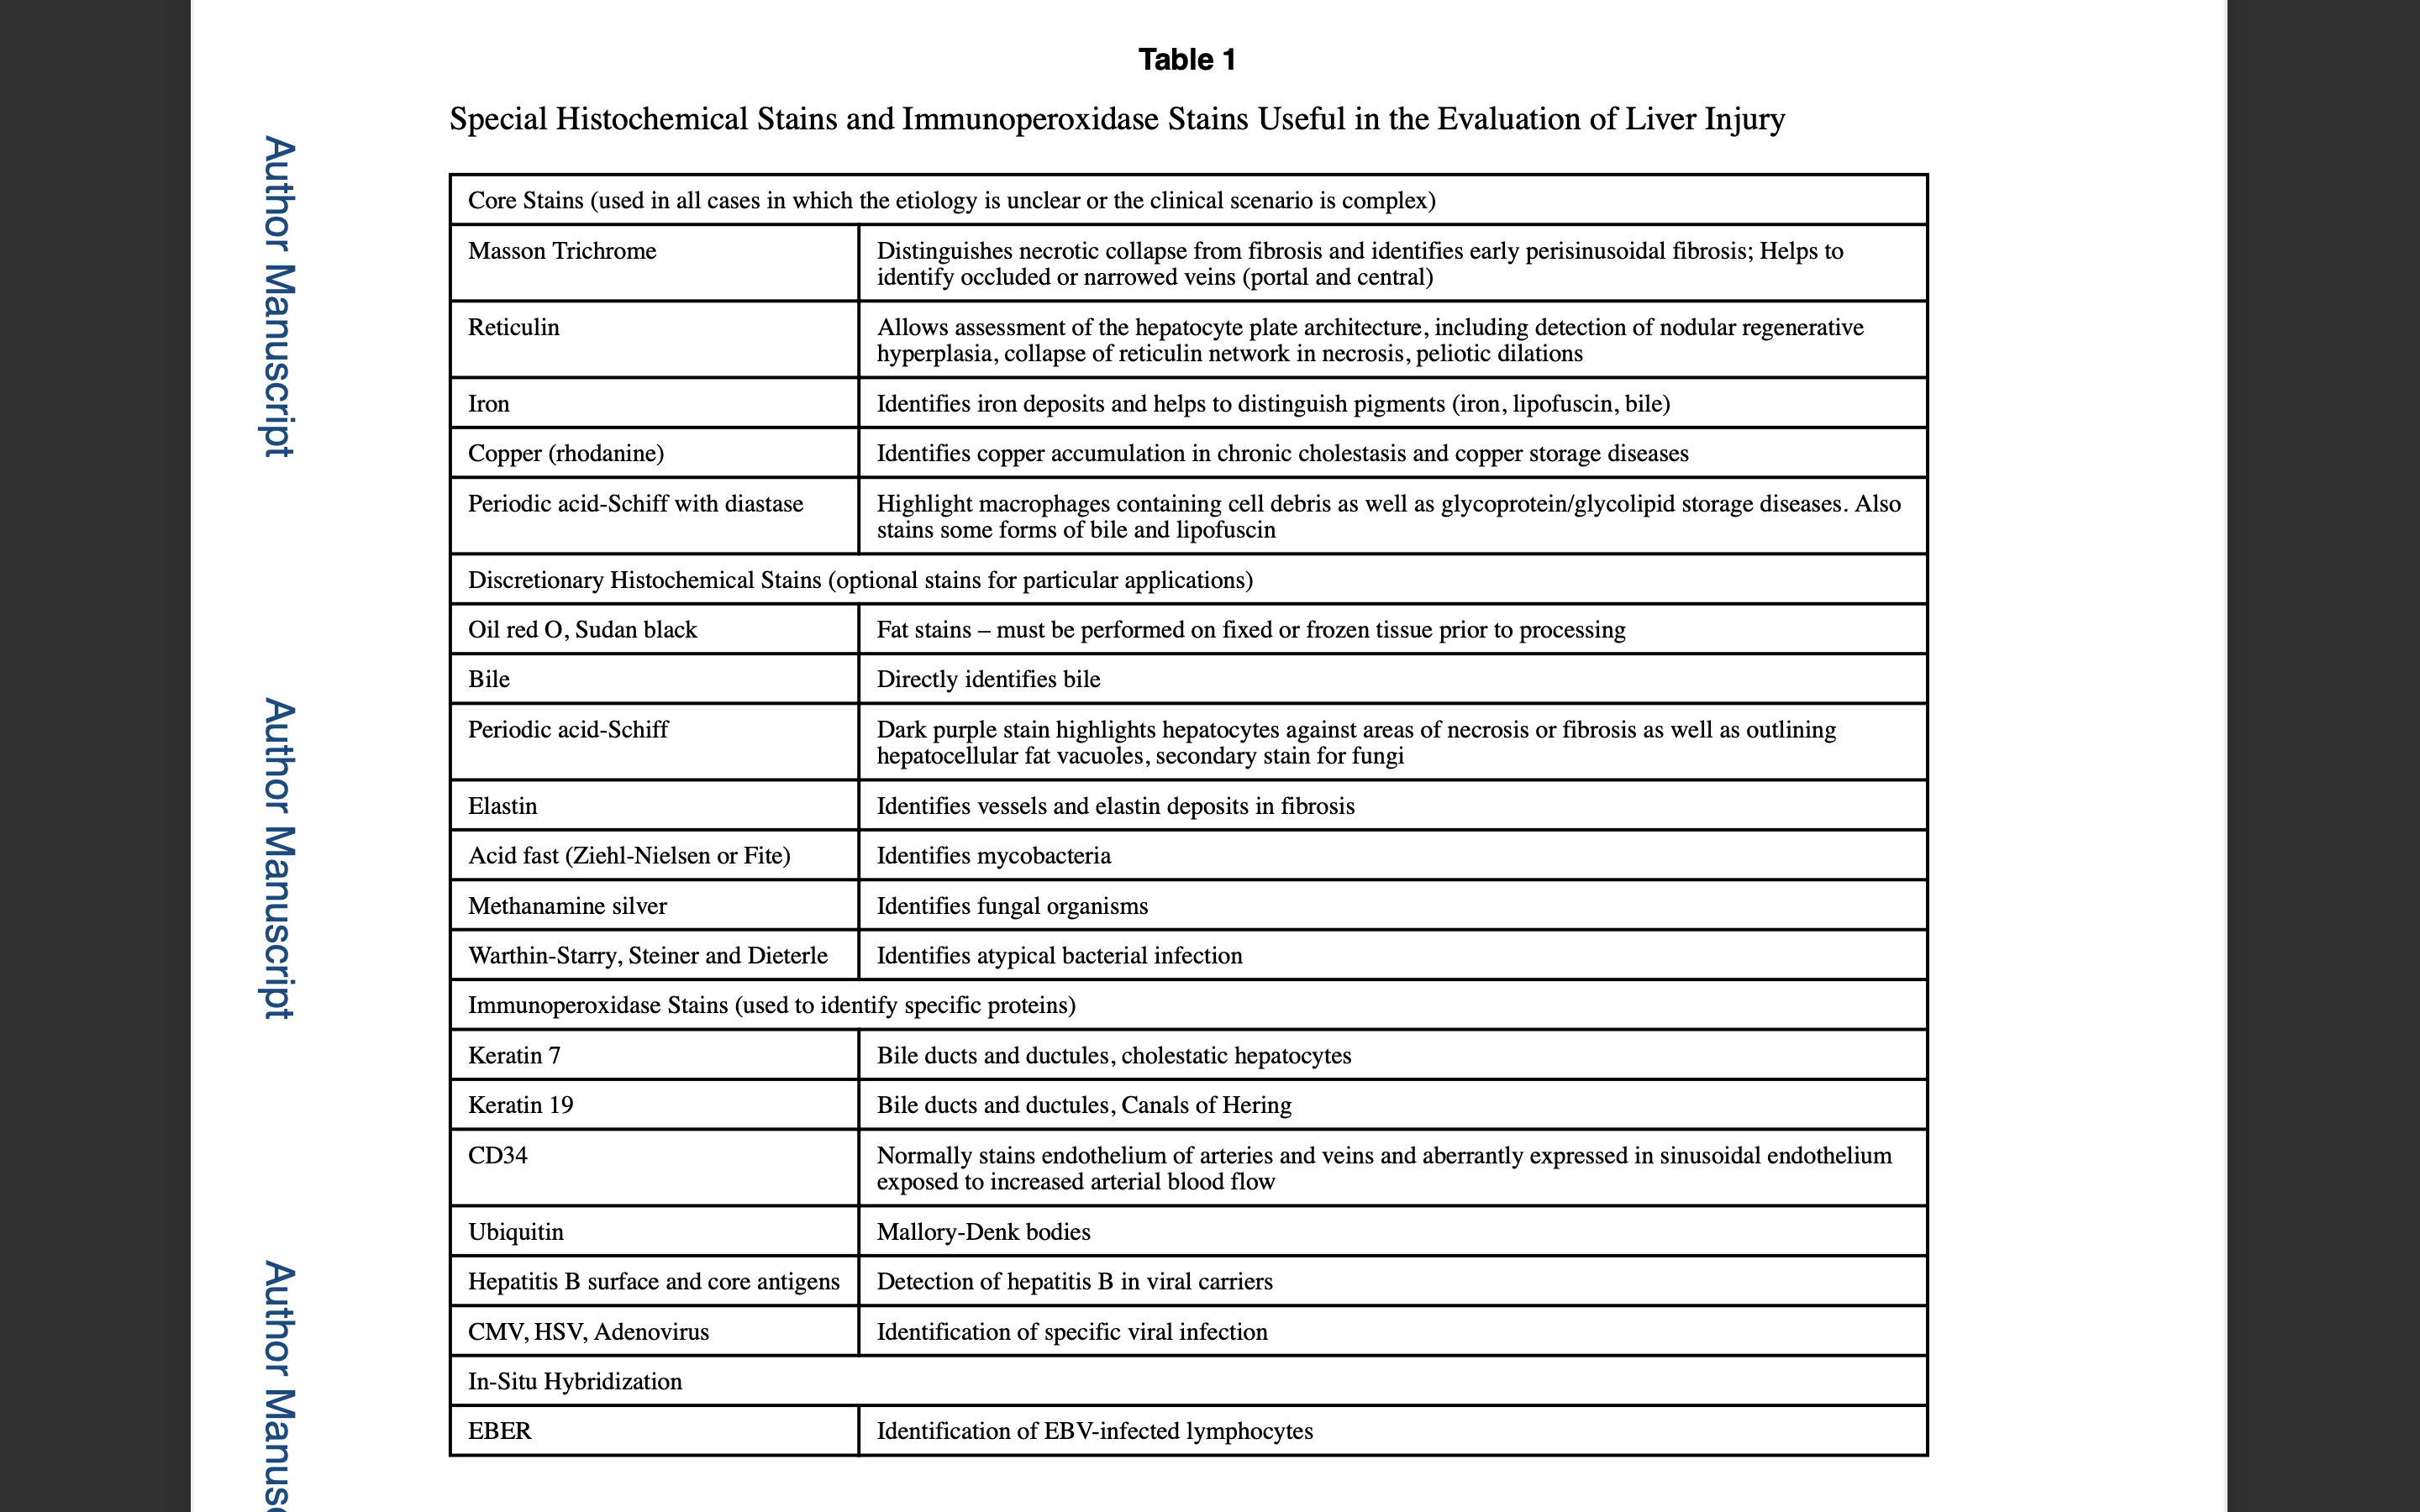
Stainings (histology, histochemistry, immunohistochemistry)

Slide 17
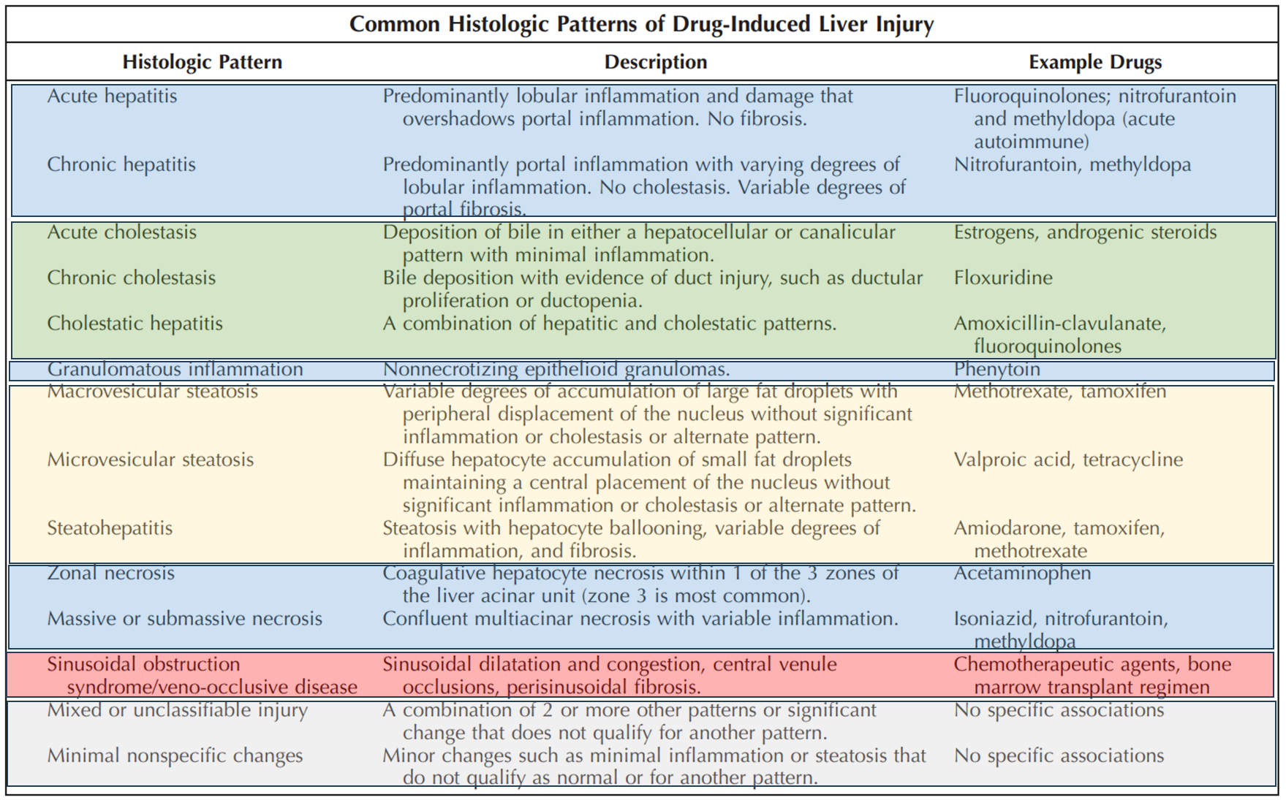
Título

Slide 18
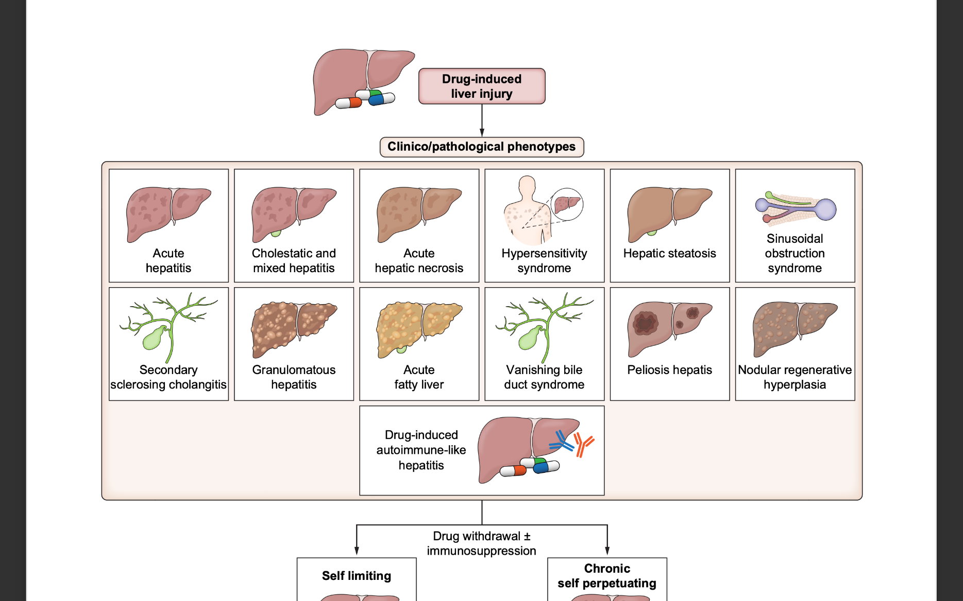
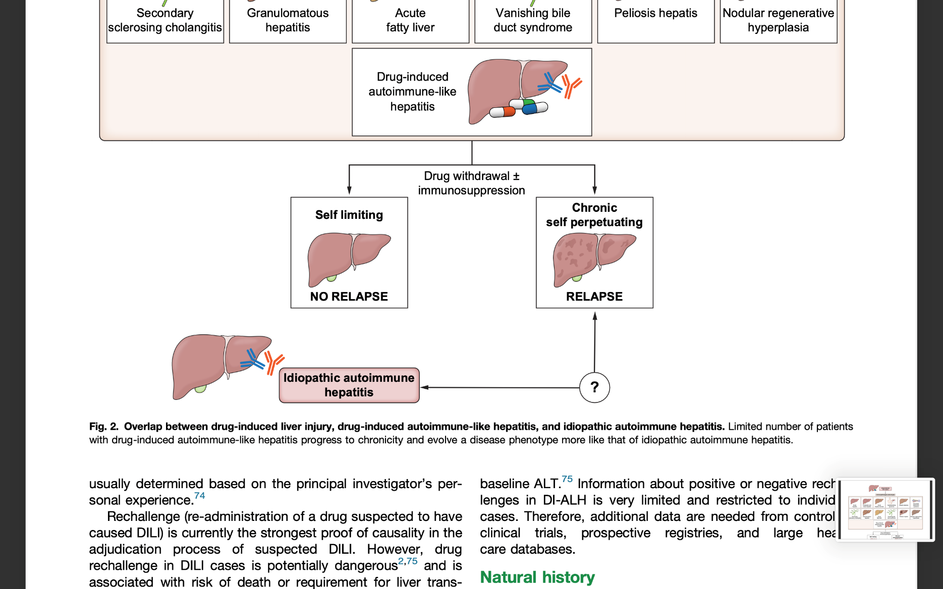
Drug-induced liver injury
RJ Andrade. J Hepatol Sept 2023, vol 79

Slide 19
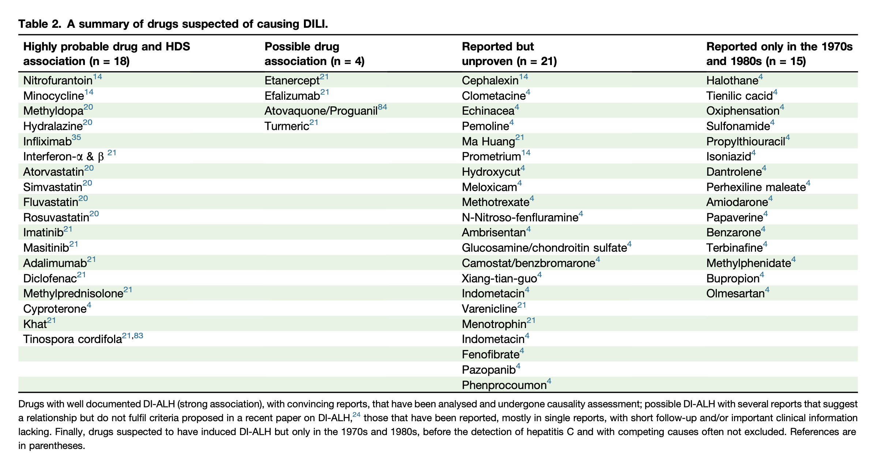
Summary of drugs suspected to cause DILI

Slide 20
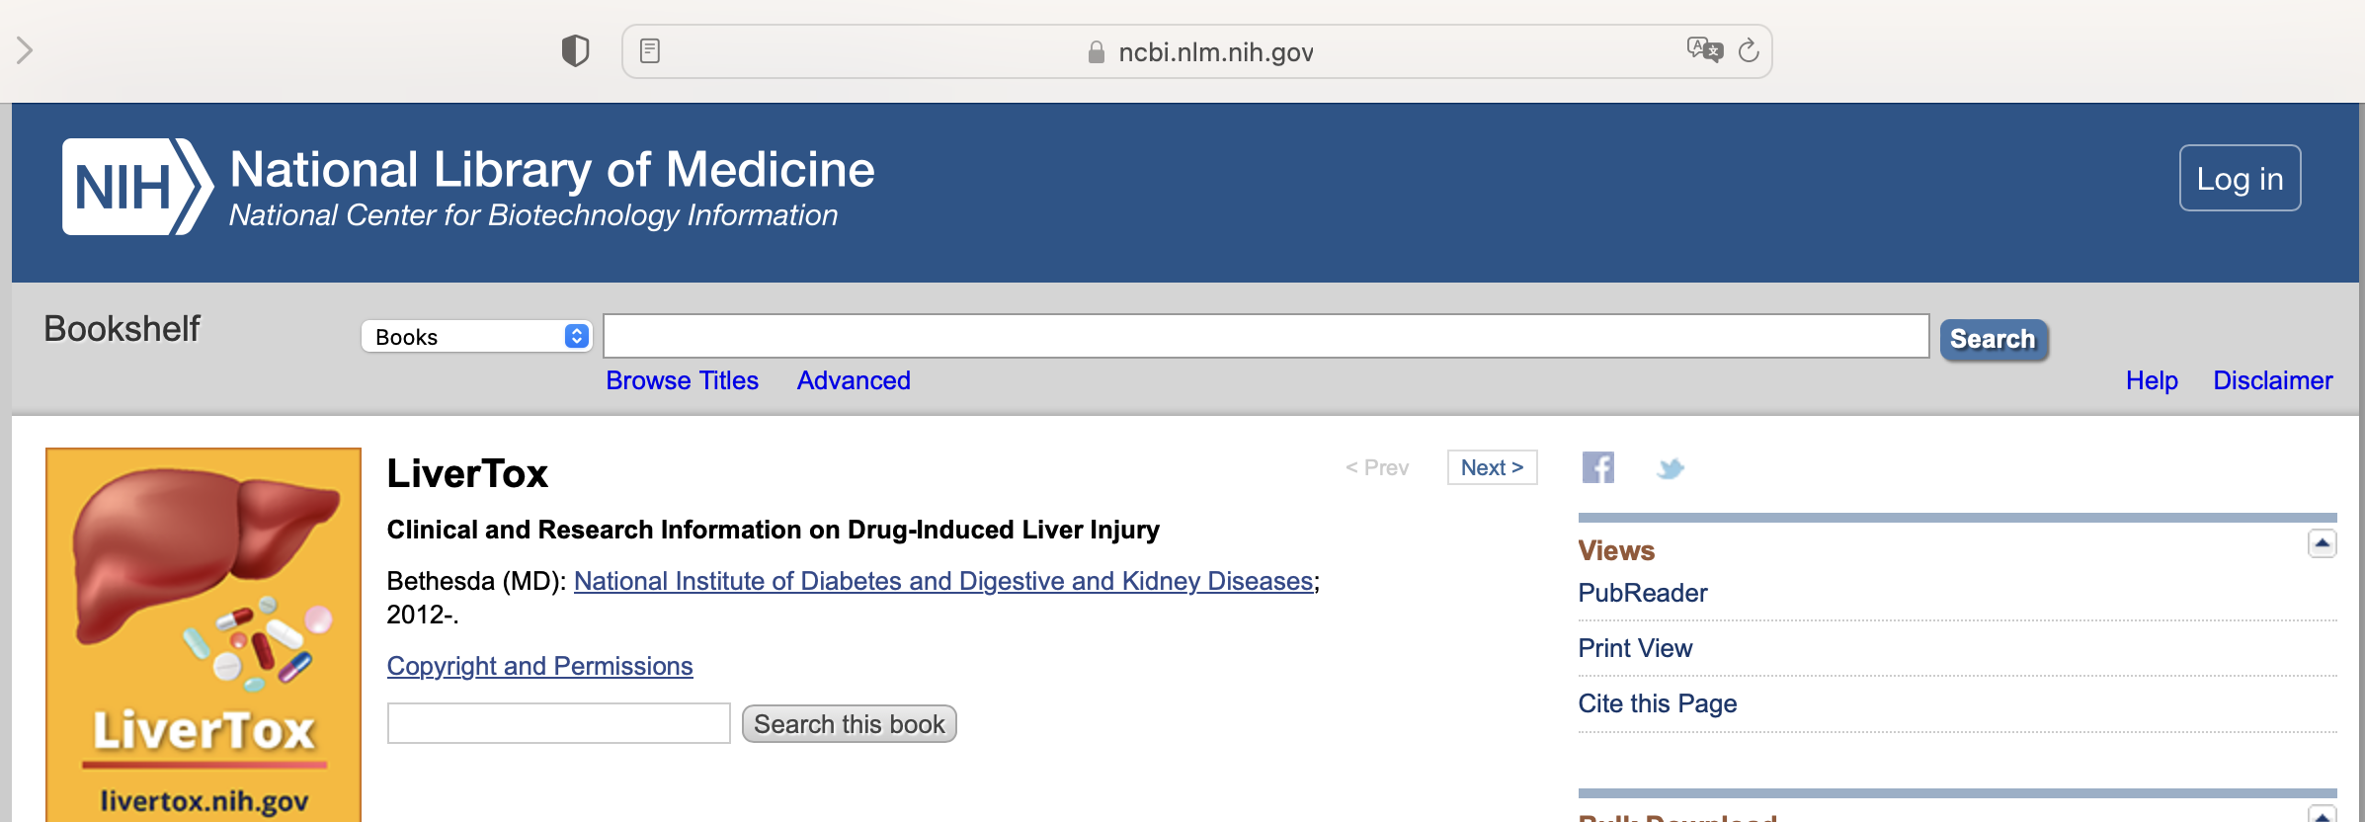

Available resourches
LiverTox – https://www.ncbi.nlm.nih.gov/books/NBK547852/
DILI specific chapters of major textbooks
PubMed – case reports, reviews
Notes:
Comment on the possibility or not, of the medication in question being associated with the observed pattern of injury."

Slide 21
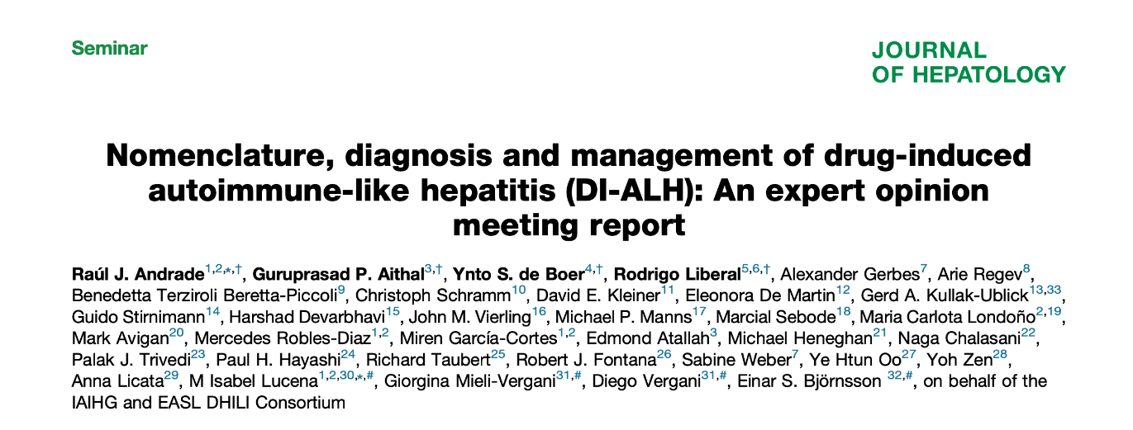
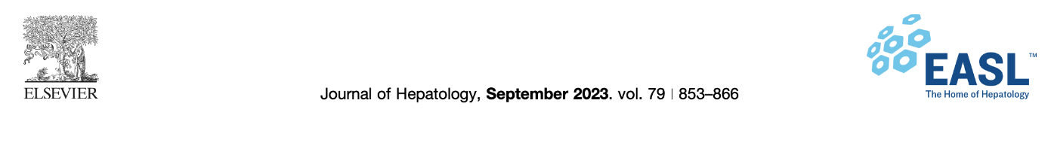
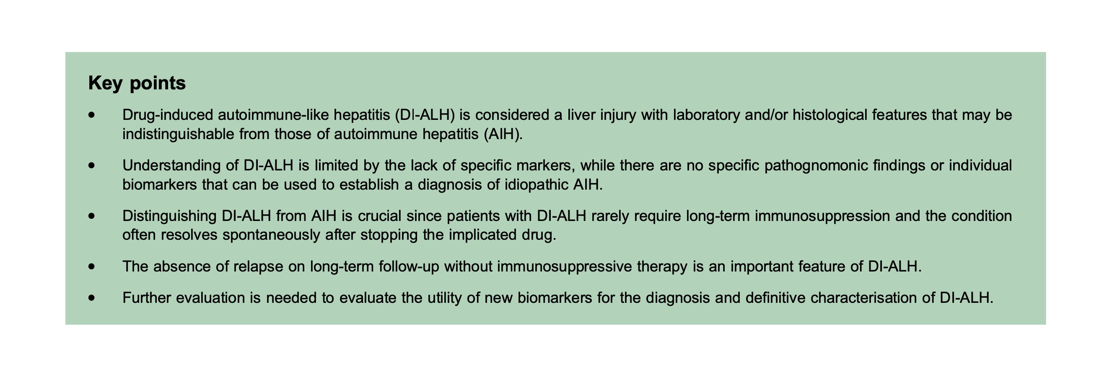
Drug-induced autoimmune-like hepatitis (DI-ALH)

Slide 22
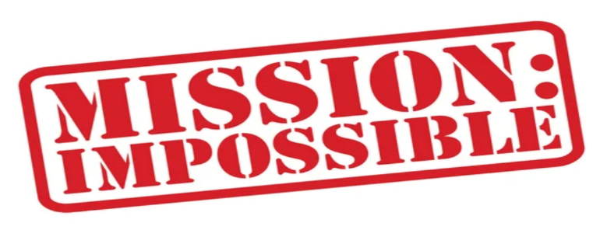
Differential diagnosis may be a challenge
DILI diagnosis should be reached only after careful consideration of other possibilities
  High prevalence of chronic viral hepatitis and fatty liver disease - be careful of underlying liver disease
  Drug induced autoimmune-like hepatitis (DI-ALH) have liver injury with laboratory and / or histological features that may be indistinguishable from autoimmune hepatitis (AIH)
    Nitrofurantoin, minocycline, hydralazine, metyldopa, statins

Slide 23
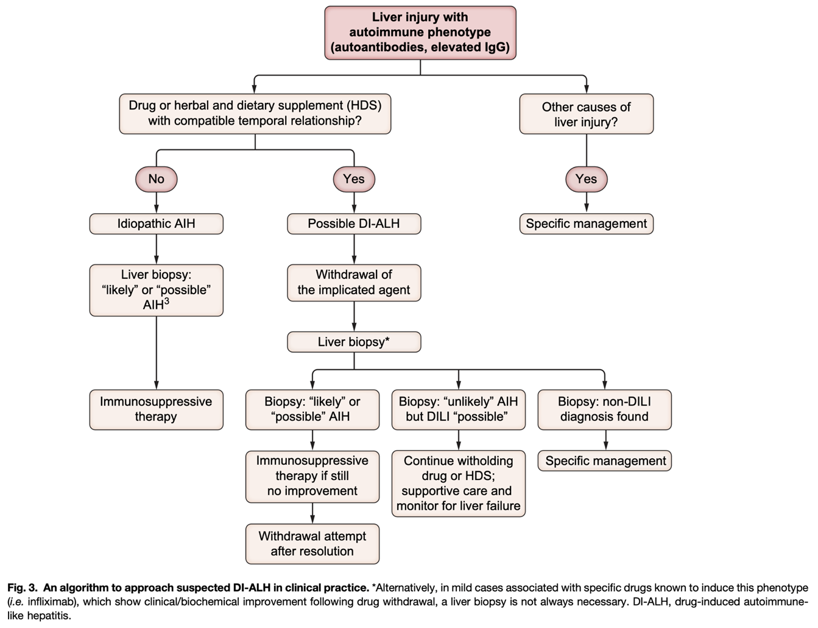
Algorithm to approach suspected for DI-ALH

Slide 24
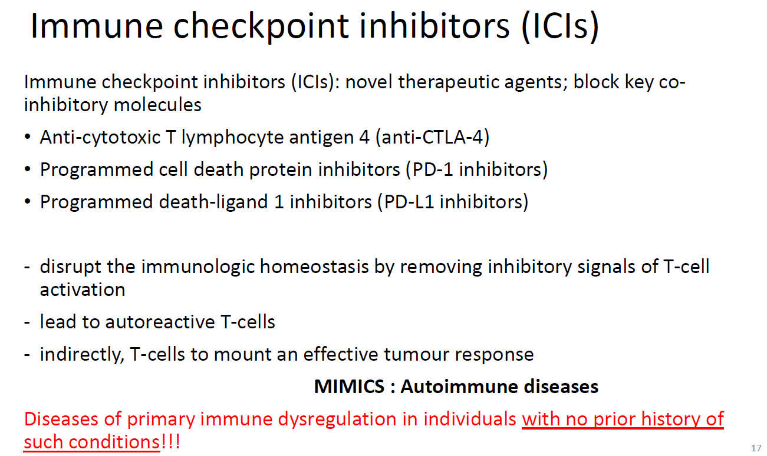
Immune checkpoint inhibitors (ICIs)

Slide 25
IATROGENIC/DRUG-induced INJURY of the GI TRACT and LIVER

Slide 26
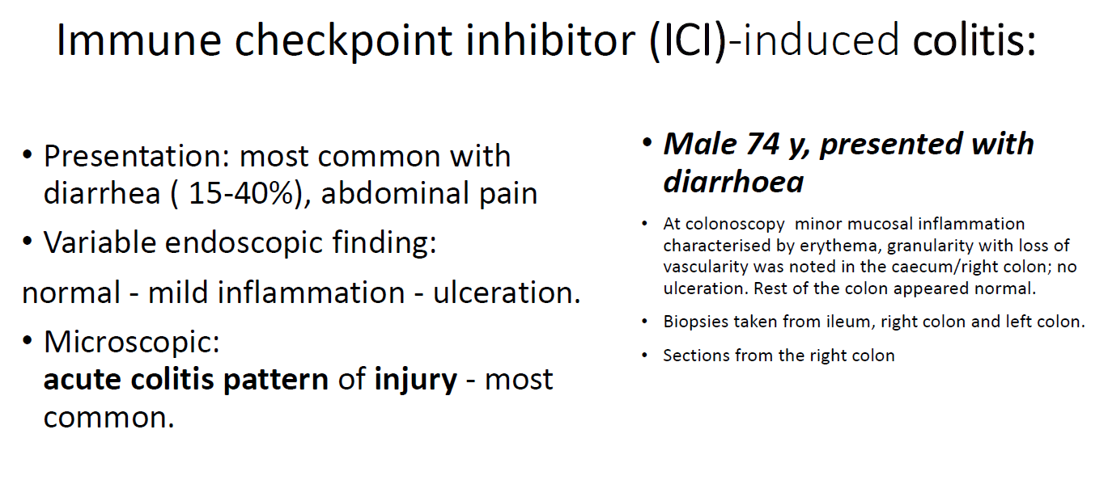
Immune checkpoint inhibitors (ICIs) induce colitis

Slide 27
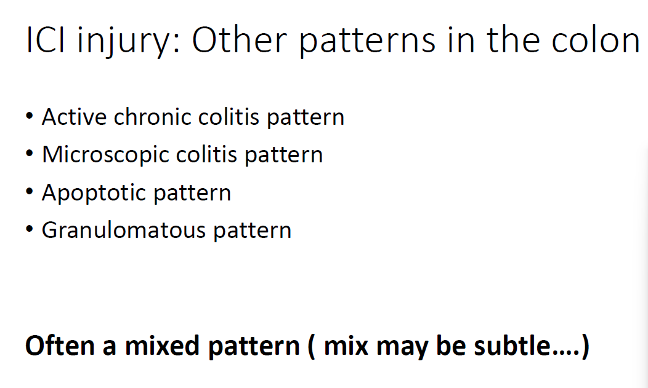
Patterns of ICI injury in the colon, besides acute colitis

Slide 28
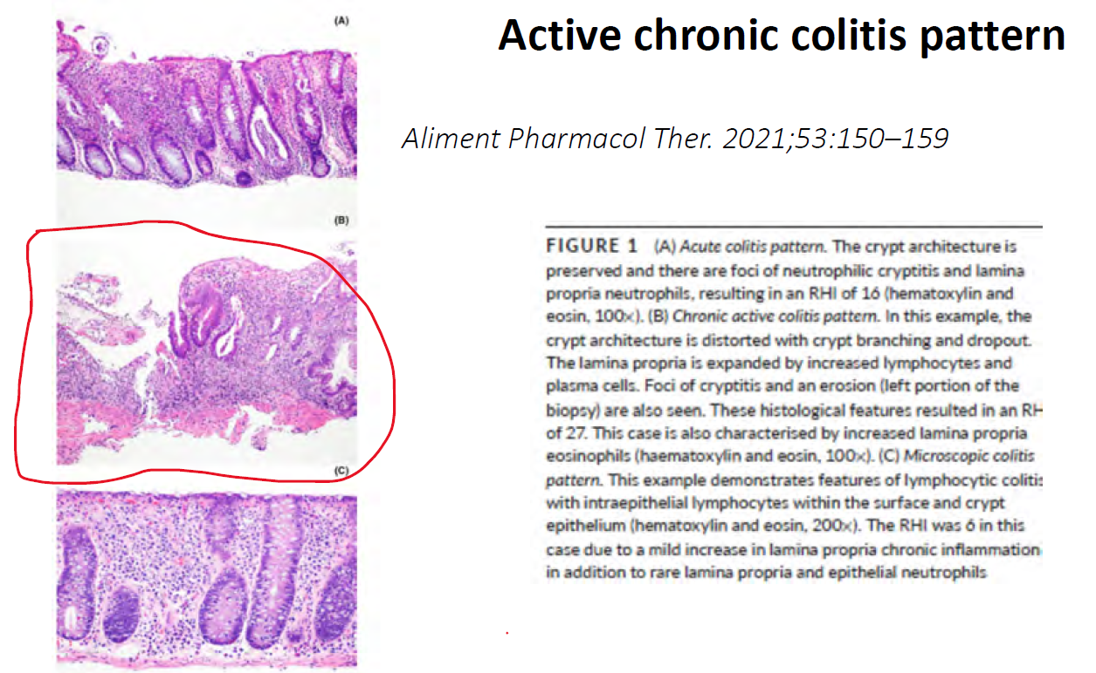
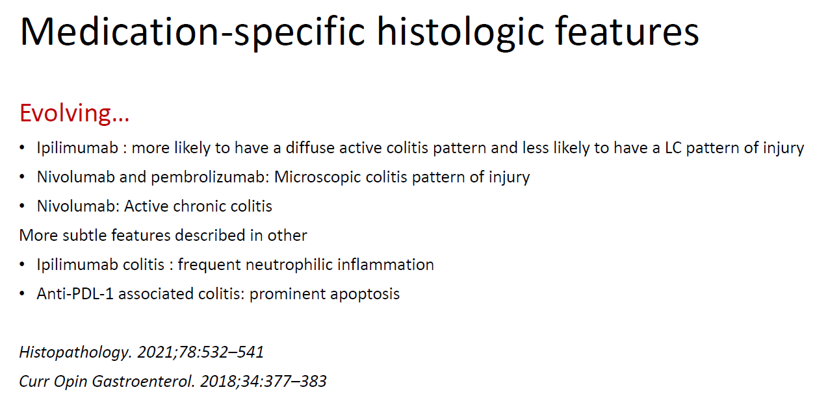
Patterns of ICI injury in the colon, besides acute colitis

Slide 29
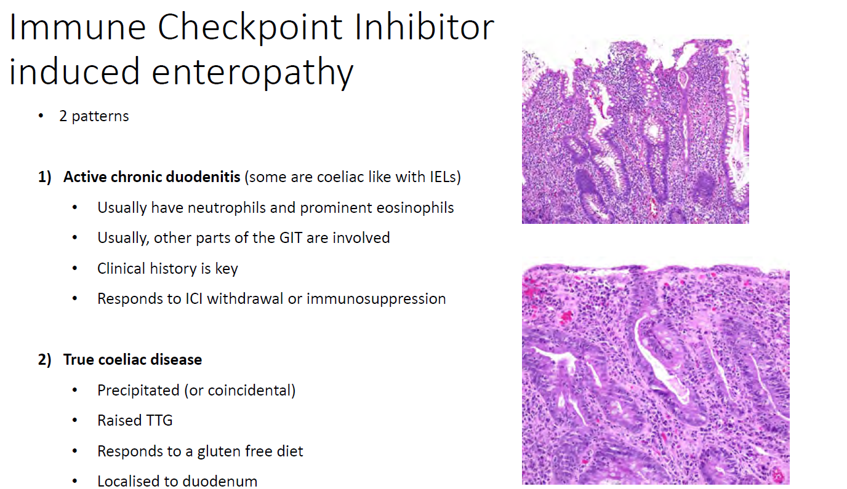
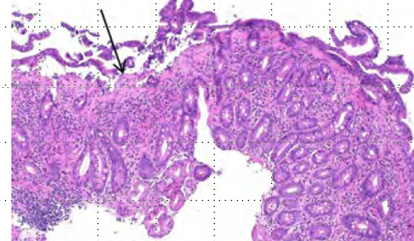
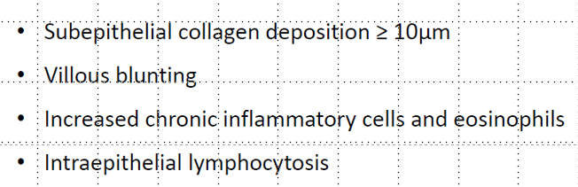
Patterns of ICI injury in the small bowel
Collageneous sprue

Slide 30
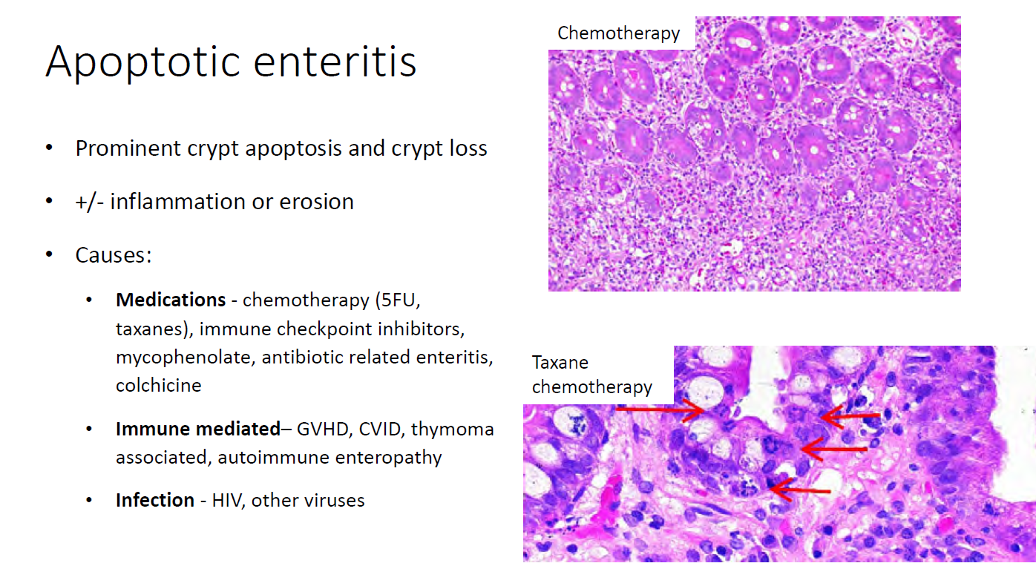
Patterns of ICI injury in the small bowel

Slide 31
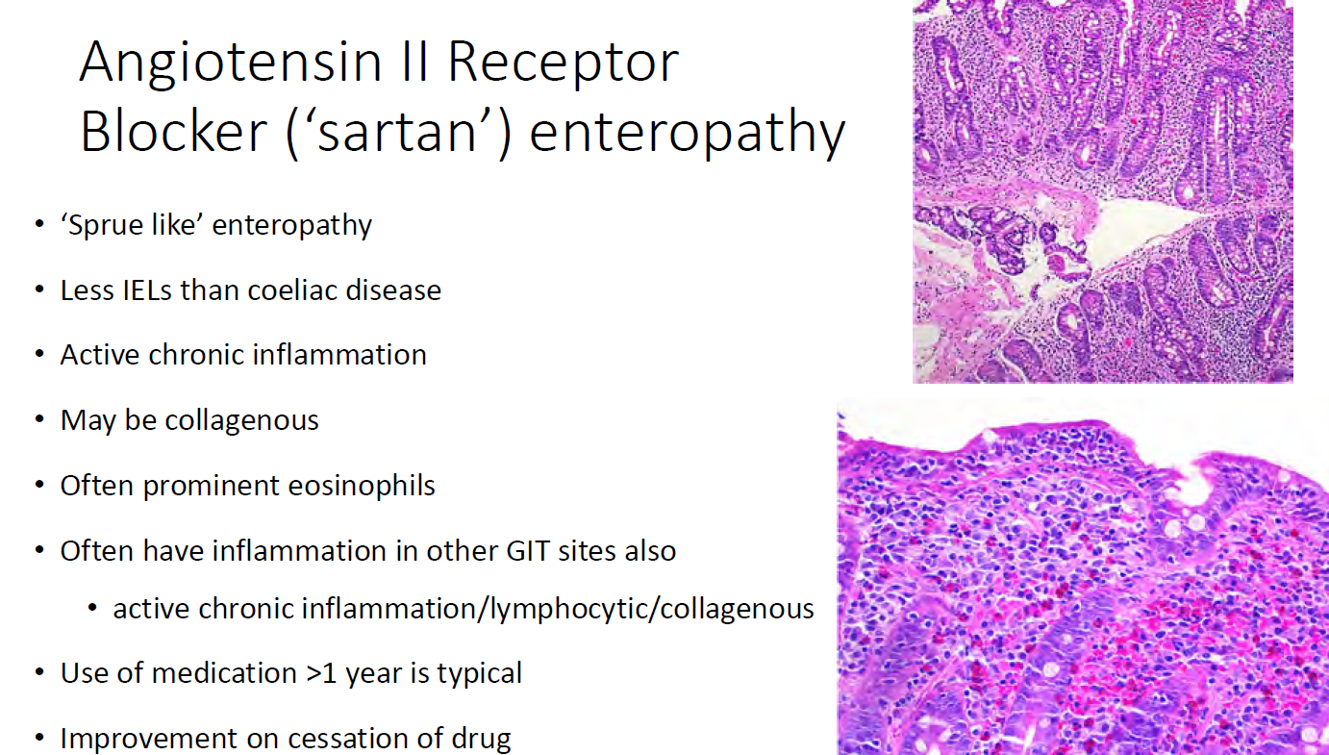
Patterns of drug-induced injury

Slide 32
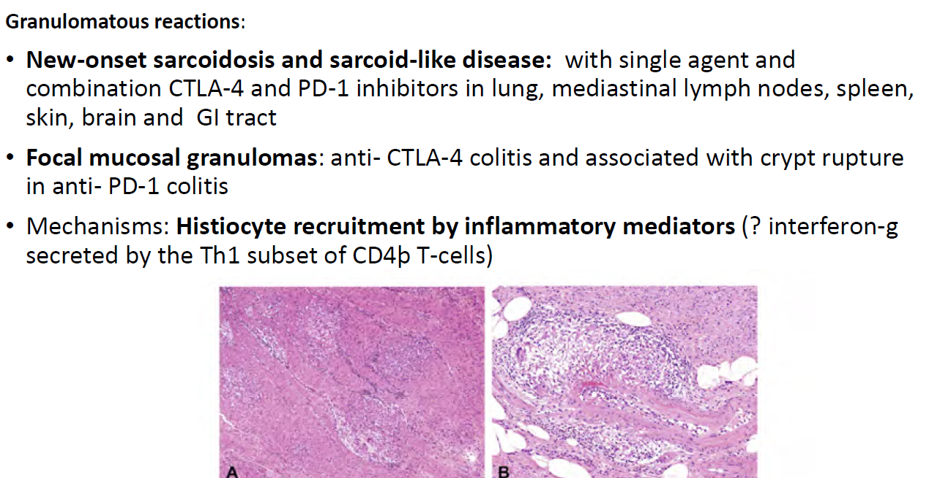
ICI in the GIT: Granulomatous reactions

Slide 33
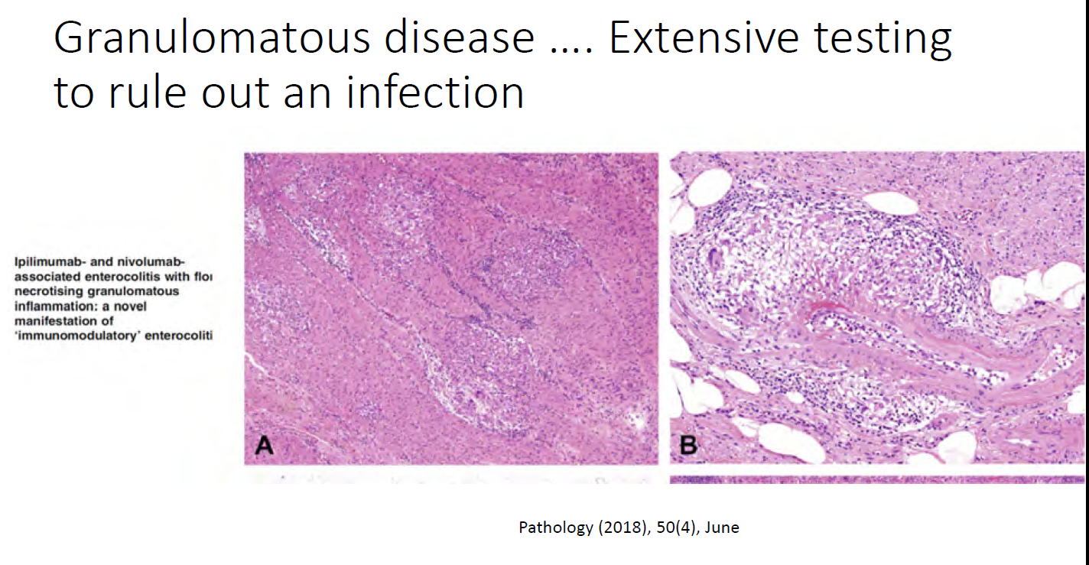
ICI in the GIT: Granulomatous reactions

Slide 34
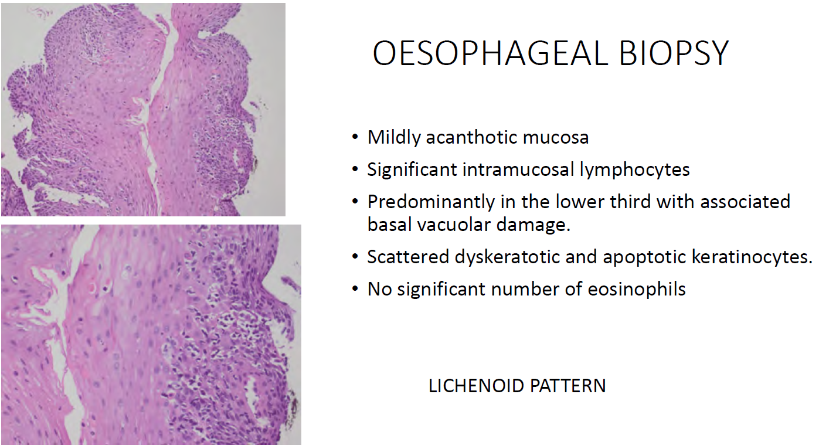
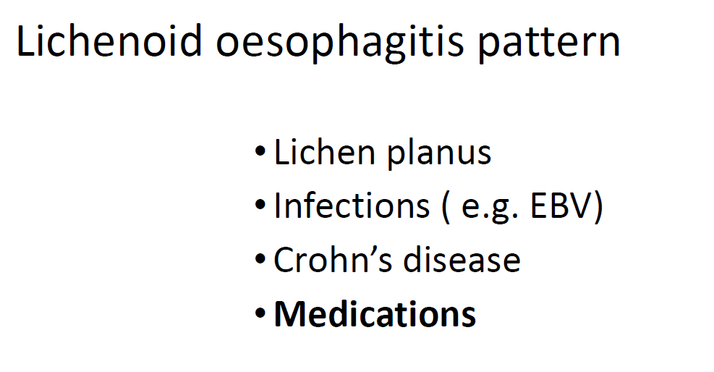
ICI injury: other sites of the GI

Slide 35
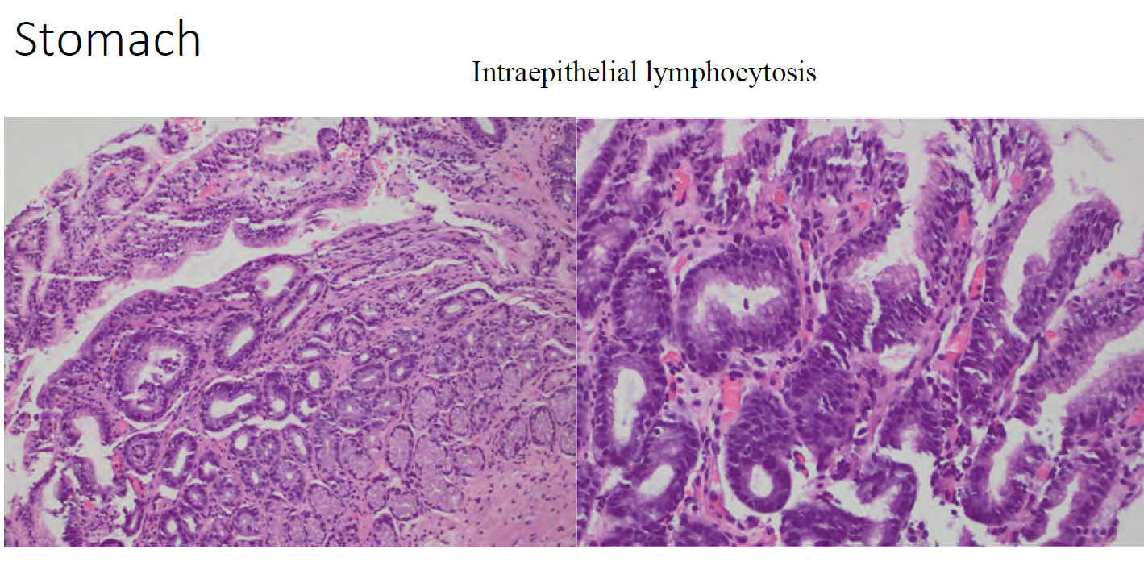
ICI in the GIT: Granulomatous reactions

Slide 36
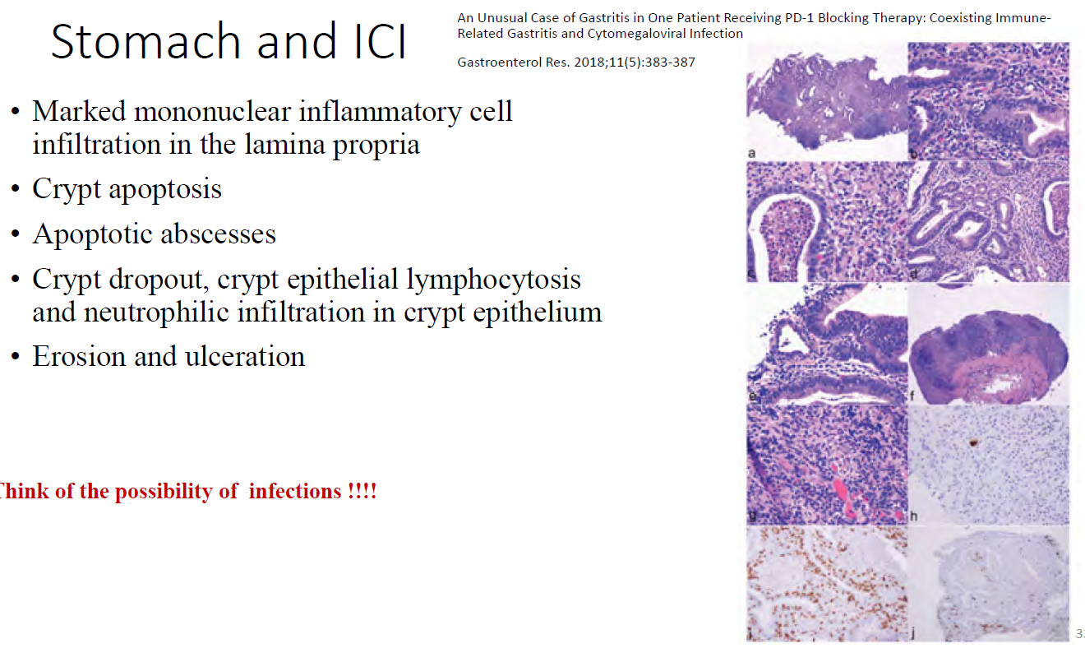
ICI in the GIT: Granulomatous reactions

Slide 37
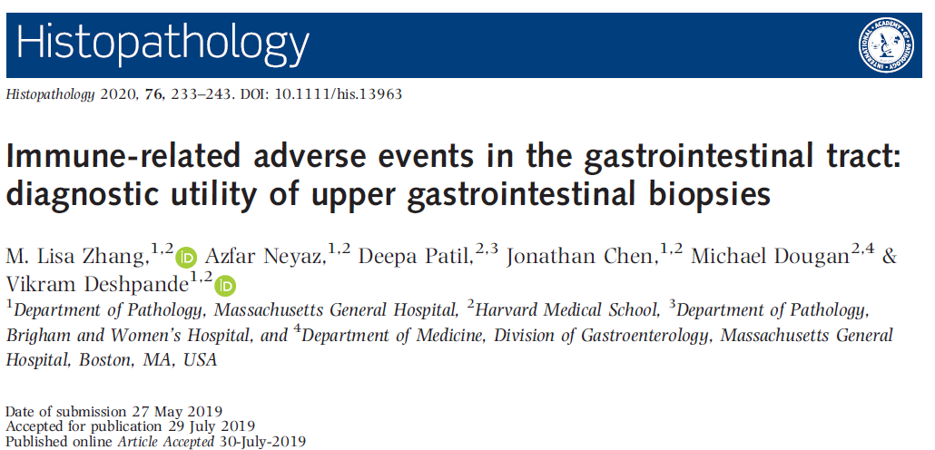
Patterns of ICI injury in the GIT:
Gastritis. A–D, Gastric periglandular inflammation (arrows), localised to the gastric pit–isthmus–neck region; mild diffuse lymphoplasmacytic infiltrate is also present in the lamina propria. E,F, Gastric non-necrotising granulomas (arrowhead). Note the absence of ruptured crypts.

Slide 38
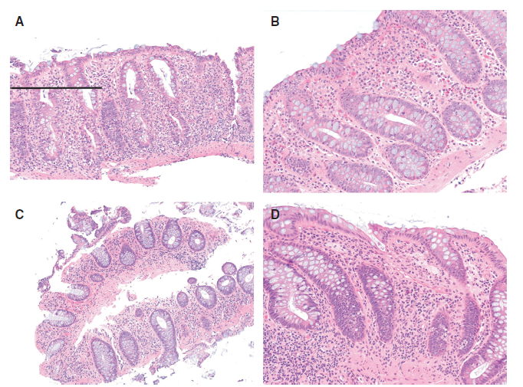
Patterns of ICI injury in the GIT:
Duodenitis. A, Duodenal mucosa with an intact villus/crypt ratio and intraepithelial lymphocytosis; B, Villous blunting, diffuse epithelial injury, and increase in the numbers of mucosal lymphocytes and plasma cells. Notably, there was no increase in the number of intraepithelial lymphocytes. C, Villous blunting and expansion of the mucosa by lymphoid infiltrate. D, Apoptotic activity (arrowhead).
Colitis. A, Acute self-limiting colitis pattern. The inset highlights
neutrophilic cryptitis. B, Lymphocytic colitis pattern. C, Collagenous colitis pattern. D, Apoptosis-only pattern.

Slide 39
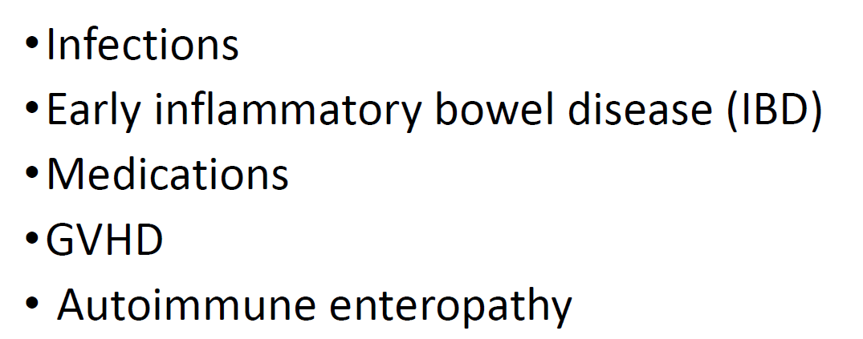
ICI injury: differential diagnosis

Slide 40
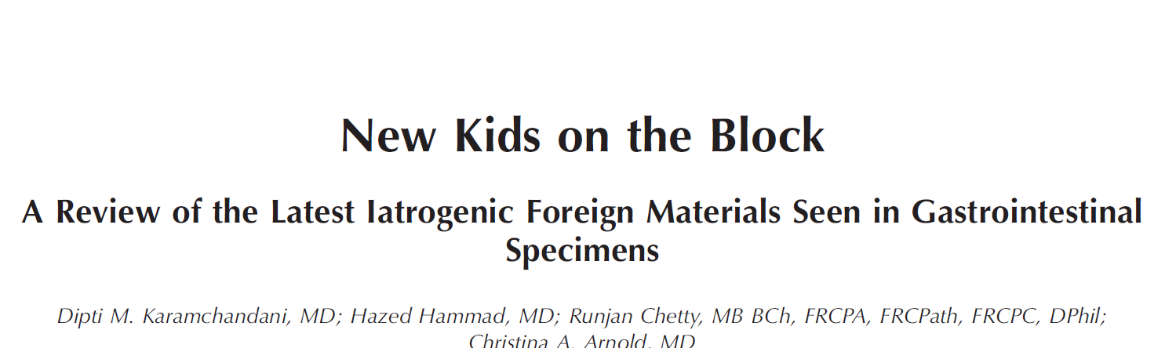
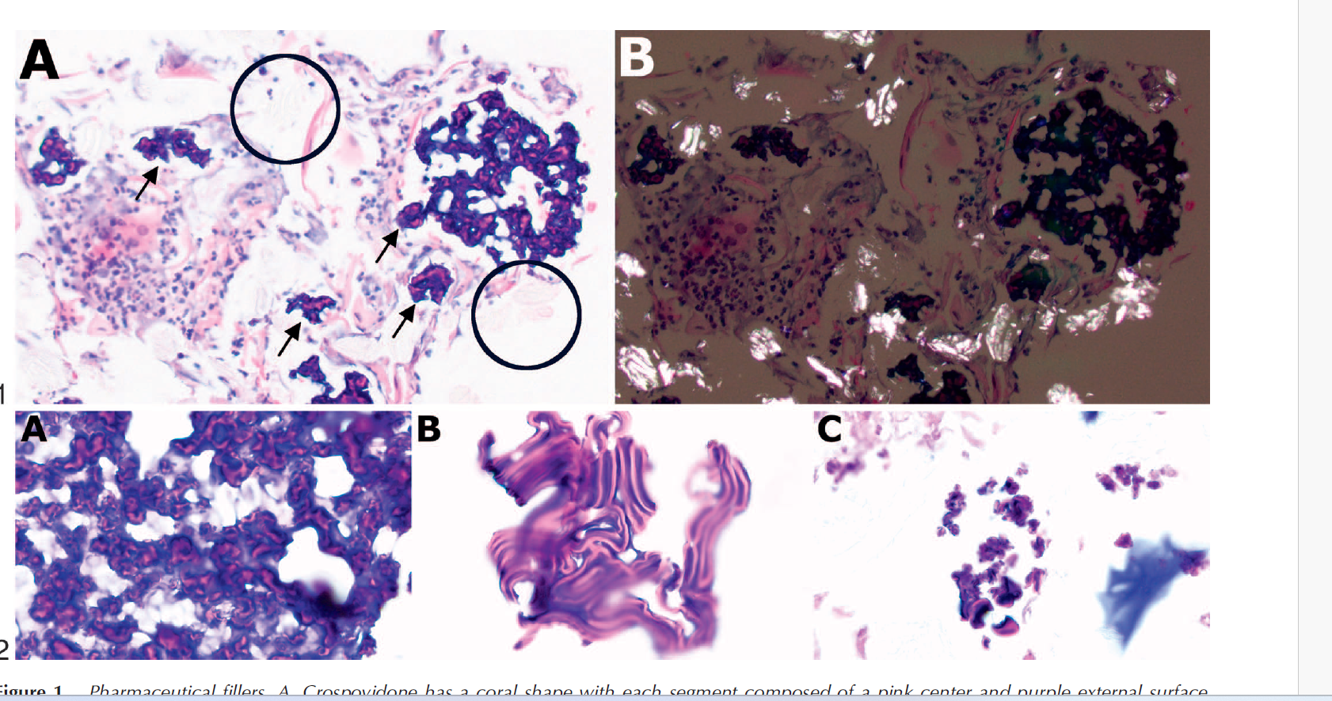
(Arch Pathol Lab Med. doi: 10.5858/arpa.2020-0535-RA)
Figure 1. Pharmaceutical fillers.
A, Crospovidone has a coral shape with each segment composed of a pink center and purple external surface (arrows), and microcrystalline cellulose (MCC) has a rod or matchstick shape and is colorless (circles) on hematoxylin-eosin stain.
B, Under polarized light, crospovidone is nonbirefringent and MCC is brightly birefringent (original magnification 3400 [A]; hematoxylin-eosin, original
magnification3400 [B]).

Slide 41
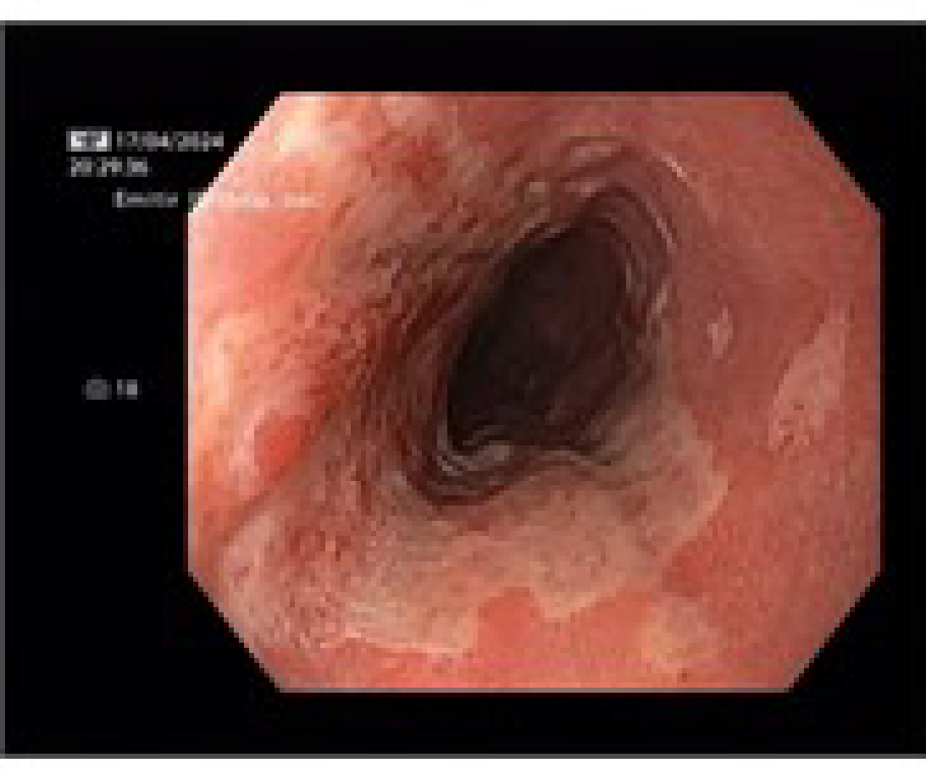
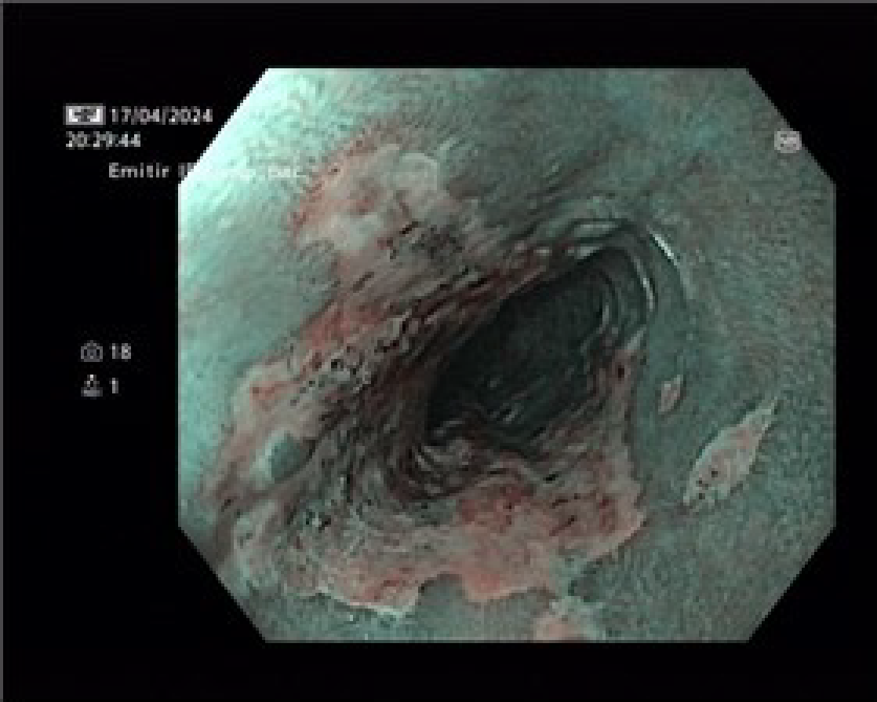


Iatrogenic/Drug-induced injury in children
Female, 16 years
Sudden intense pain
Ulcer (2/3 of esophageal circimference) medio, de 26 a 31 cm, ocupando 2/3 de la circunferencia de la luz

Slide 42
Iatrogenic/Drug-induced injury in children

Slide 43


Iatrogenic/Drug-induced injury in children

Slide 44


Iatrogenic/Drug-induced injury in children
Male, 12 years
Abdominal pain and diarrhea
One month before: cold sore in the mouth
Inflammatory Bowel Disease?

Slide 45






Clinical history:
Male, 11-year-old, with iron-deficiency
anaemia and occult gastrointestinal tract
blood loss.
The use of nonsteroidal anti-inflammatory drugs (NSAIDs) was denied. Microbiologic study of stools was negative.
The patient was submitted to video capsule endoscopy which was inconclusive due to the retention of the capsule in the small bowel, requiring surgical removal; an intraoperative enteroscopy was performed.

Slide 46




Diaphragm Disease is characteristically associated to the use of NSAIDs
NSAIDs act on cyclo–oxygenase to inhibit the synthesis of prostaglandins, the loss of which damages enterocytes, alters villous microcirculation and disrupts mucosal integrity.
NSAIDs can also have a local mucosal effect by uncoupling ATP synthesis in the mitochondria of enterocytes. Resulting tissue disturbance can lead to circumferential ulceration with the mucosa further vulnerable to damage by bacteria or toxins

Slide 47





Diaphragm Disease is characteristically associated to the use of NSAIDs
AJR Am J Roentgenol. 2014;202(2):W140-5

Slide 48

Diaphragm Disease
Once seen,
never forgotten!

Slide 49

Thank You!

Slide 52

ICI injury in the GIT

